Slide 1
Application Methods
Use and Characteristics of Herbicides for Non-crop Weed Control pp. 20-27
Herbicides and Forest Vegetation Mgmt pp. 6-10, 15-17

Slide 2
Application Techniques
Cut-surface Treatments
Bark Treatments
Foliage Treatments
Soil Treatments

Slide 3
Cut-surface Treatments
Frill Girdle (spaced cuts)
  Hack and Squirt
Stem Injection
  Hypo-hatchet
  E-Z Ject
Cut Stump

Slide 4
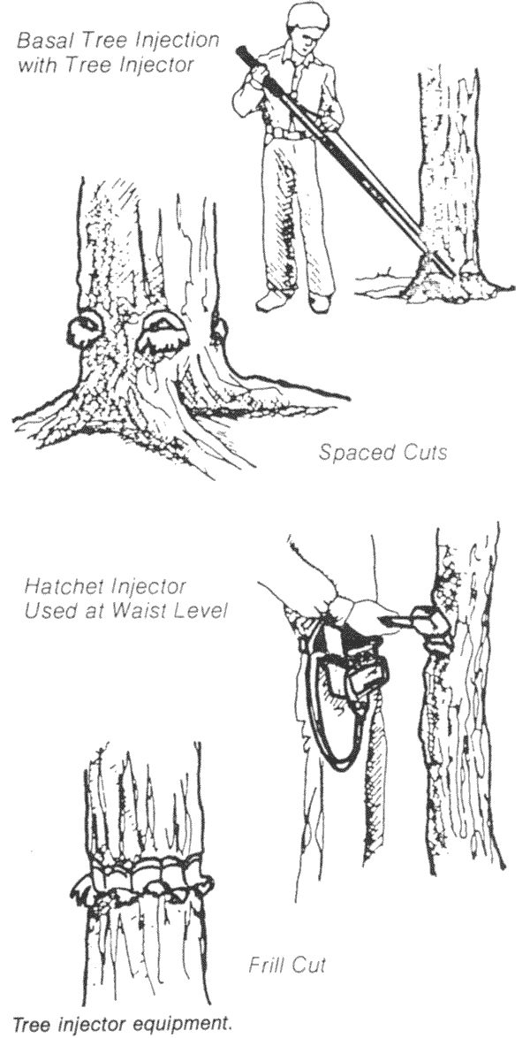
Cut-surface Treatments
Frill girdle (continuous vs. spaced, likely most resprouting)
Stem injection
  Injector delivers 1 mL/cut, space cuts 2 in.
  Hypo-Hatchet delivers 1 mL/cut, space cuts 1 in. for larger trees
Cut stump (often used)
www.bugwood.org

Slide 5
Stump Treatment
Highly selective
Operational timing flexibility
  Apply anytime except standing water, snow cover
Labor intensive compared to foliar
Low to moderate stem densities

Slide 6
How to Treat a Stump
Cut down tree
Spray stump with blue stuff in squirt bottle

Slide 7
Why Treat Stumps?
Most woody species have dormant buds in their stems
When the stem is cut, these dormant buds begin to grow, forming resprouts

Slide 8
Why Treat Stumps?
Resprouts grow very quickly because of the stored energy in the stump and roots
Within a few seasons, the clearance gained from the cutting is lost.
A lot of money is spent for little effect

Slide 9
Woody Stem Anatomy
Bark
Phloem
Cambium
Current Xylem
Last Year’s Xylem

Slide 10
Killing the Cambium
Killing the cambium prevents new stem growth
Even if the roots are still alive, if there are no stems (and leaves) the roots will starve and die

Slide 11
Most Effective
Leave as little stump as possible
Treat stump immediately after cutting
Treat all the way to soil line

Slide 12
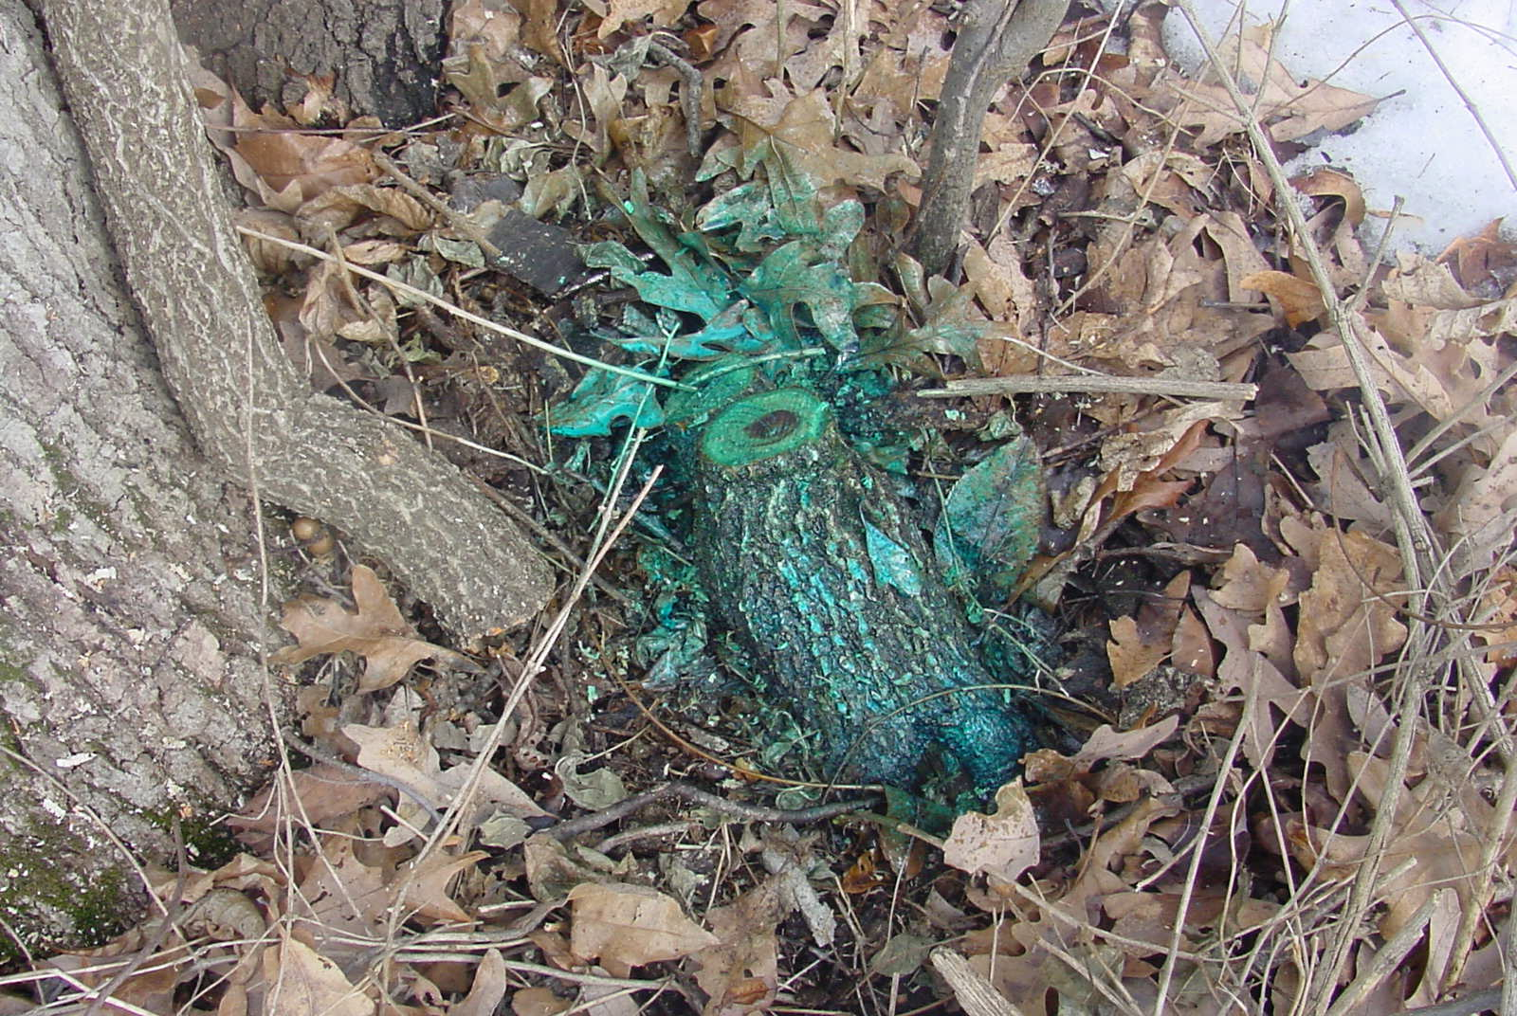

Slide 13
Why Use Triclopyr?
Triclopyr is available in oil-soluble formulations:
  Garlon 4 - concentrate
  Pathfinder II - RTU
Triclopyr works pretty well against almost all tree species
Triclopyr is not soil active

Slide 14
Why Oil Soluble?
Bark is better penetrated with an oil-based mixture
An oil soluble mixture gives you some application flexibility you don’t have with water-based mixes

Slide 15
Equipment
Trigger spray bottle (preferred for CST)
  Squirt bottle
  Pump bottle
Backpack sprayer (basal mainly)

Slide 16
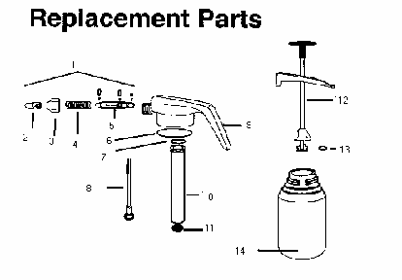


Slide 17
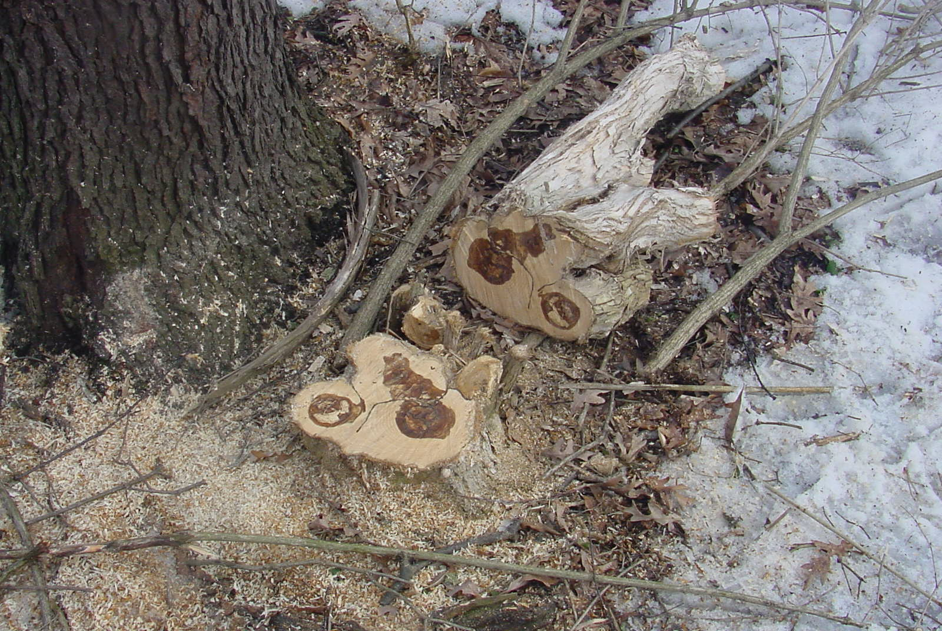

Slide 18
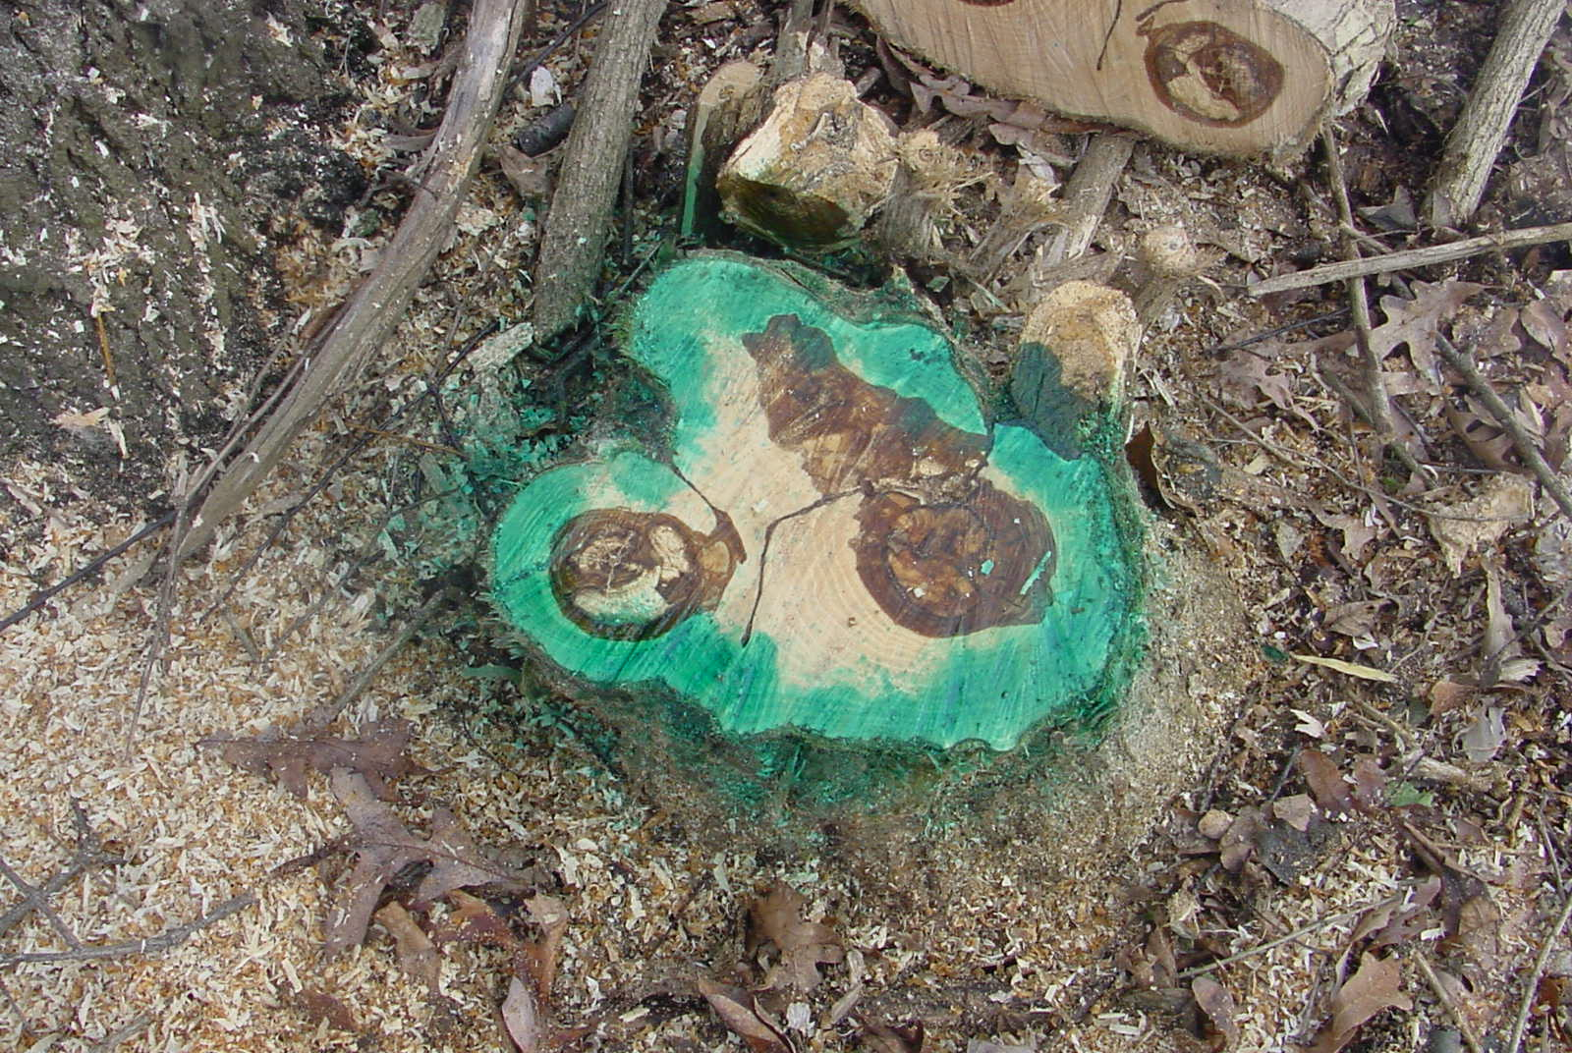

Slide 19
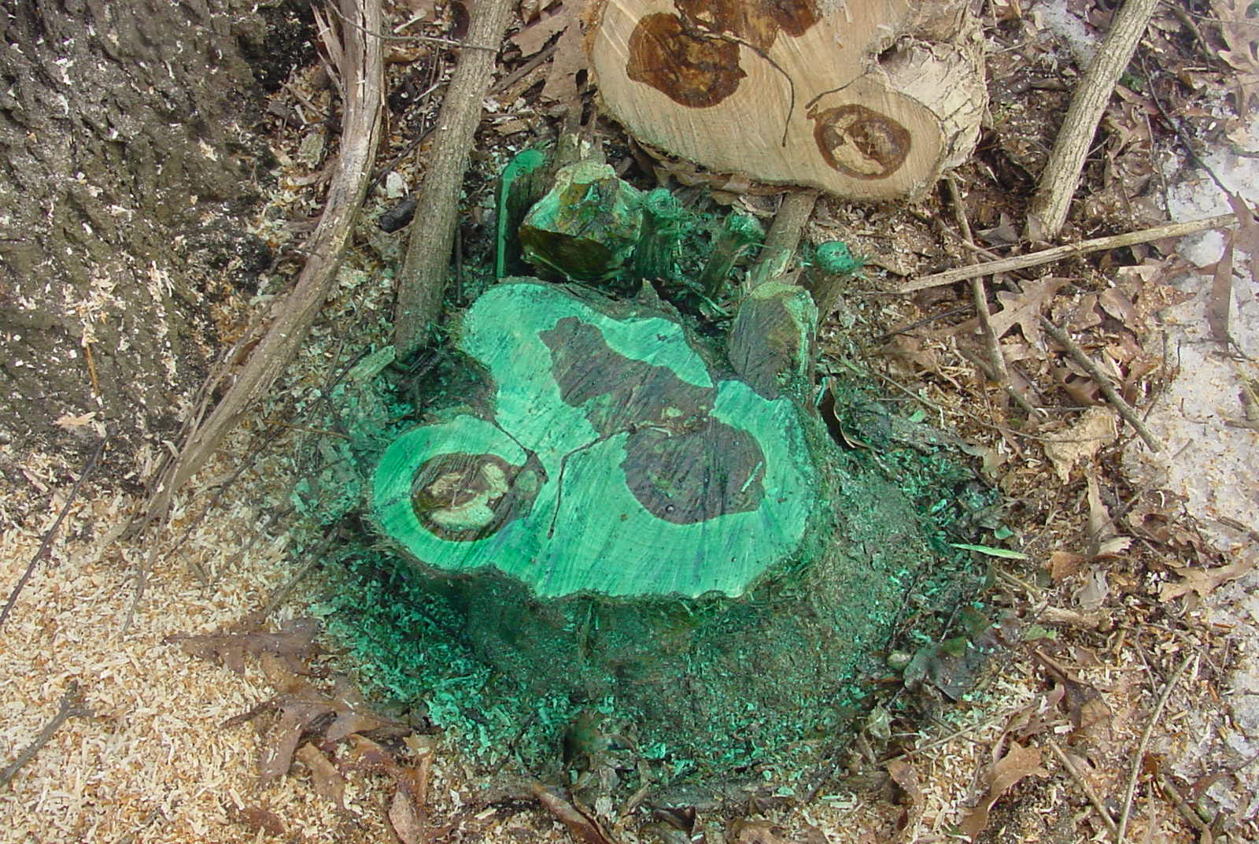

Slide 20
Bark Treatment
(aka basal bark)
Application Technique
Equipment
Herbicides
Timing

Slide 21
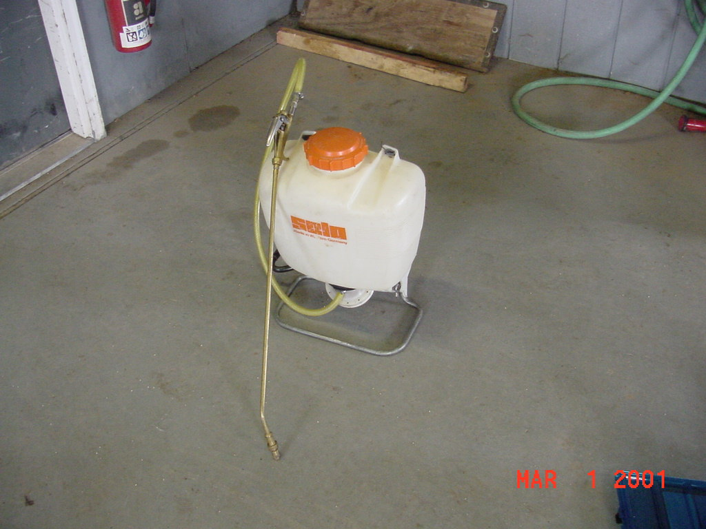
Basal Bark Treatment
Application Technique
Equipment
Herbicides
Timing

Slide 22
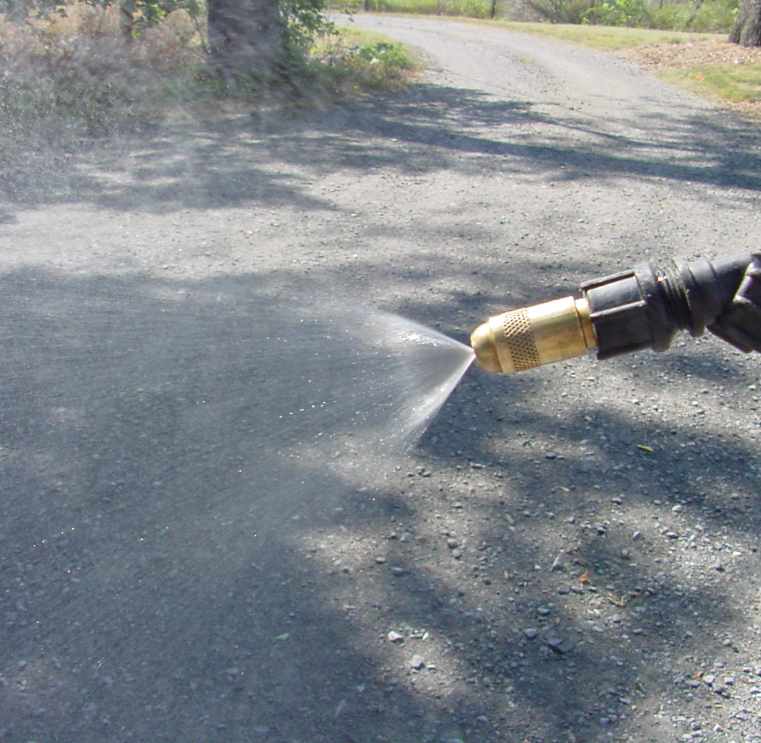
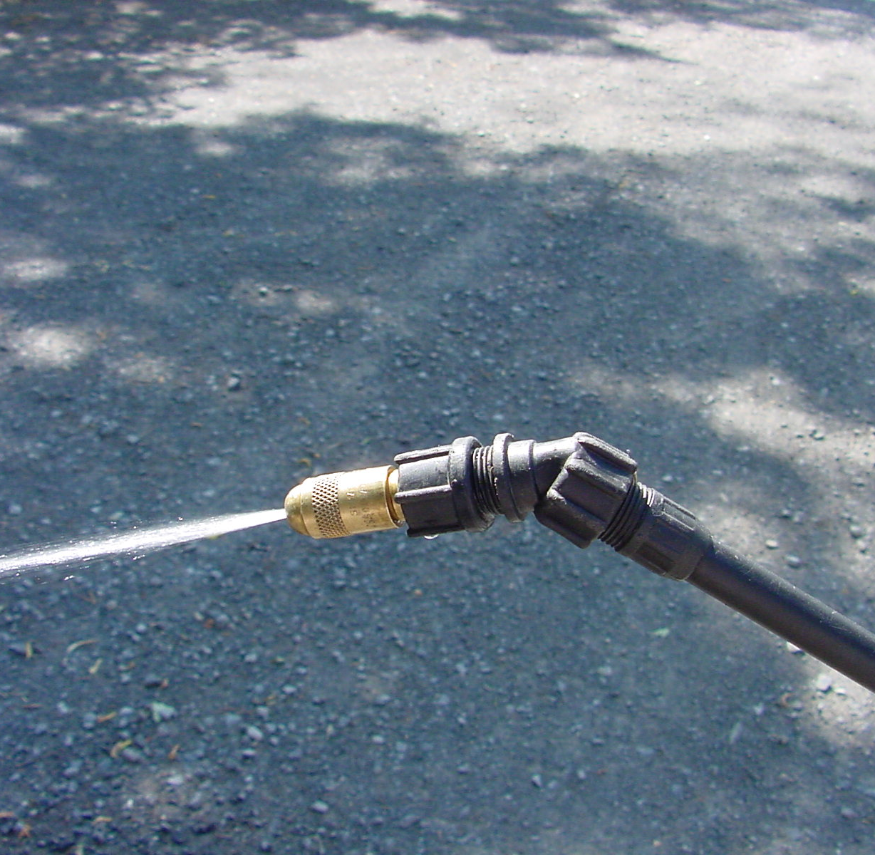
Adjustable conejet nozzle
mist pattern
stream pattern

Slide 23
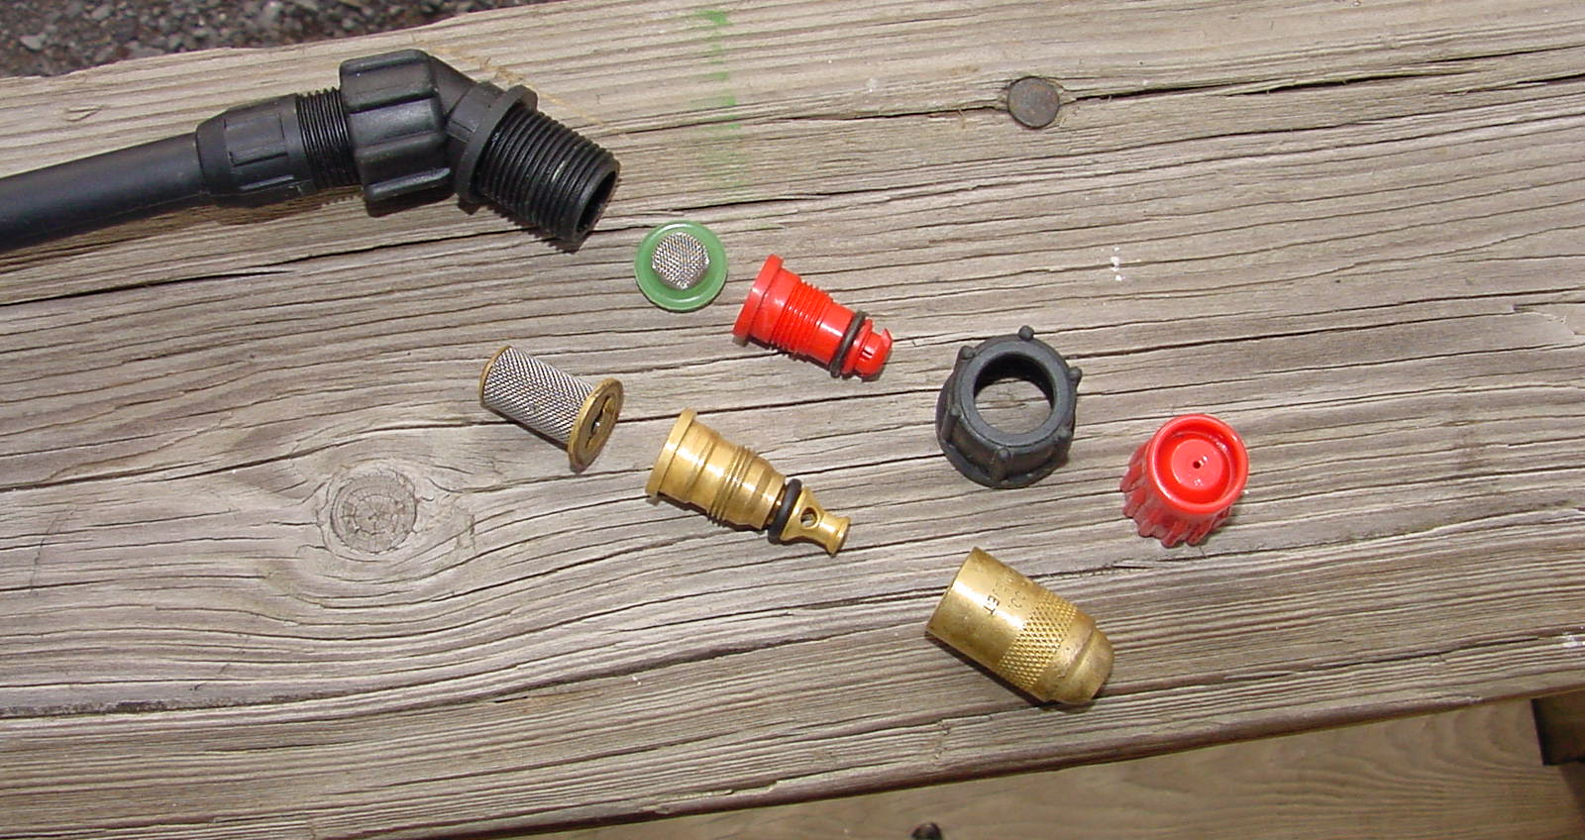
Screen or Strainer prevent clogging of nozzles check valves prevent dripping

Slide 24
Basal Bark Treatment
Application Technique
Equipment
Herbicides
Timing

Slide 25
Basal Bark Herbicides
Garlon, Pathfinder II - triclopyr
Stalker - imazapyr
All are Translocated

Slide 26
Basal Bark Treatment
Application Technique
Equipment
Herbicides
Timing

Slide 27
Basal Bark Timing
Anytime of the year
Not to be used when temperatures above 90. Possibility of volatilization.

Slide 28
How Basal Bark Works
Eventually kill stem tissue at application site
Prevent adventitious shoots - new stems

Slide 29
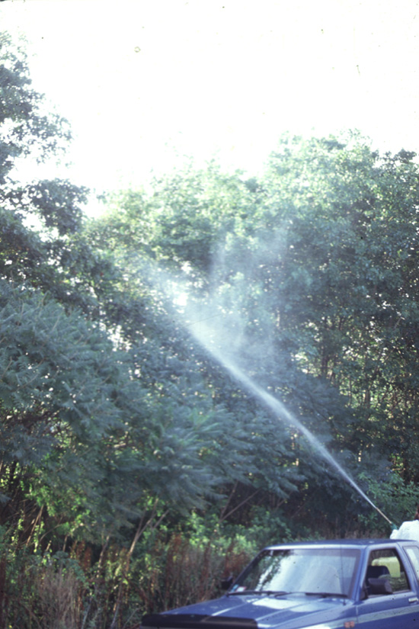
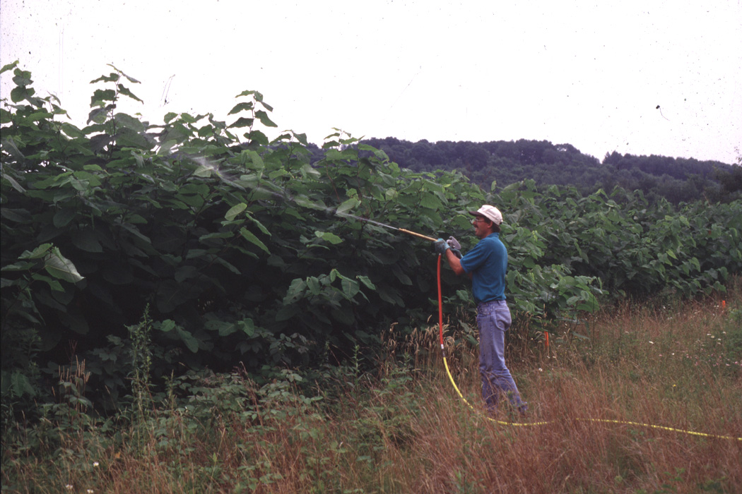
Foliage Treatments
(High Volume)
High volume 100-500 gal/ac
High Pressure
  (can create fine mist)
Careful of Drift!
Notes:
Systemic herbicides most effective on perennial plants when applied in late summer, fall when energy directed toward root system.

Slide 30
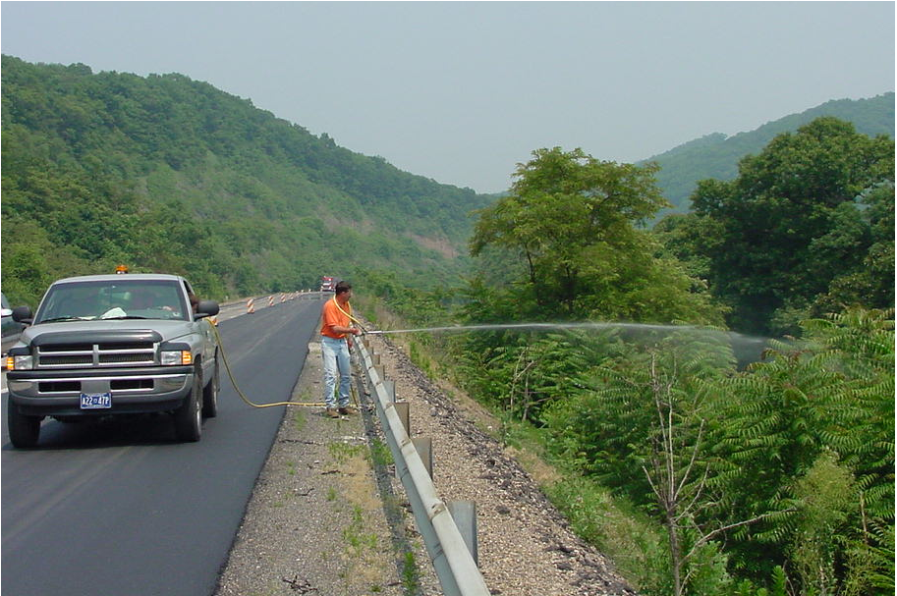
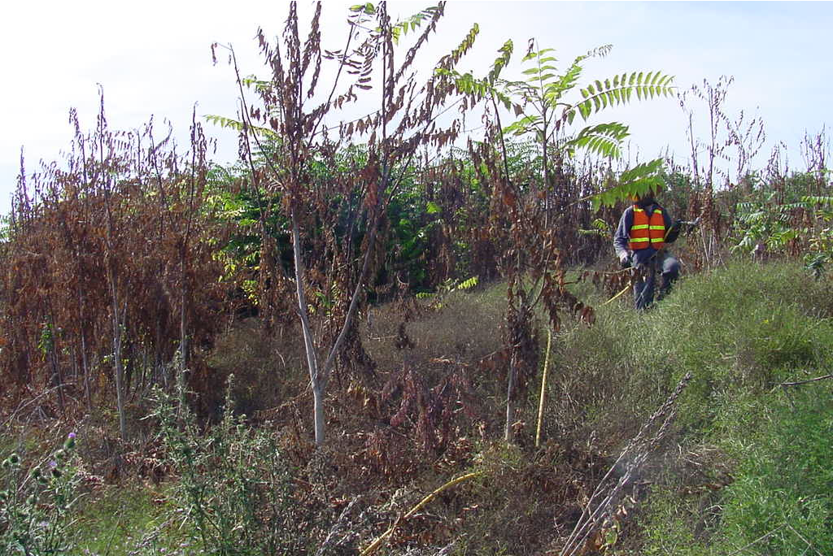
Foliage Treatments
(High Volume)
Used for high density vegetation
May cause ‘brown-out’
Sometimes we have to bite the bullet

Slide 31
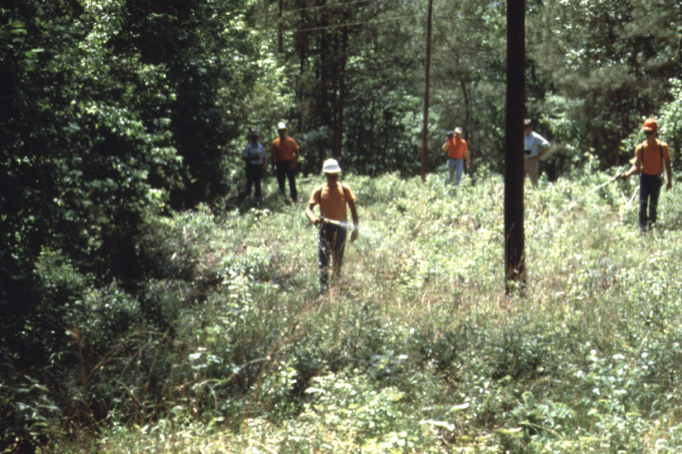
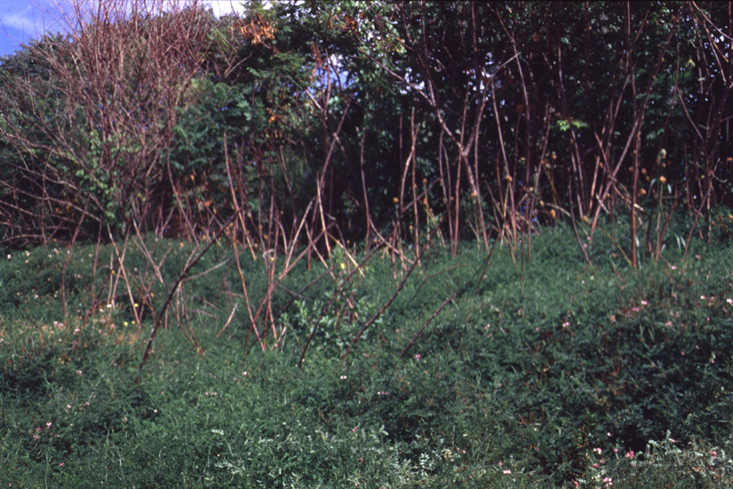
Foliage Treatments
(Low Volume)
Low density vegetation
Selective placement
Low gal/acre (5-20 GPA)
Higher concentration (5 – 10%)
Low pressure

Slide 32
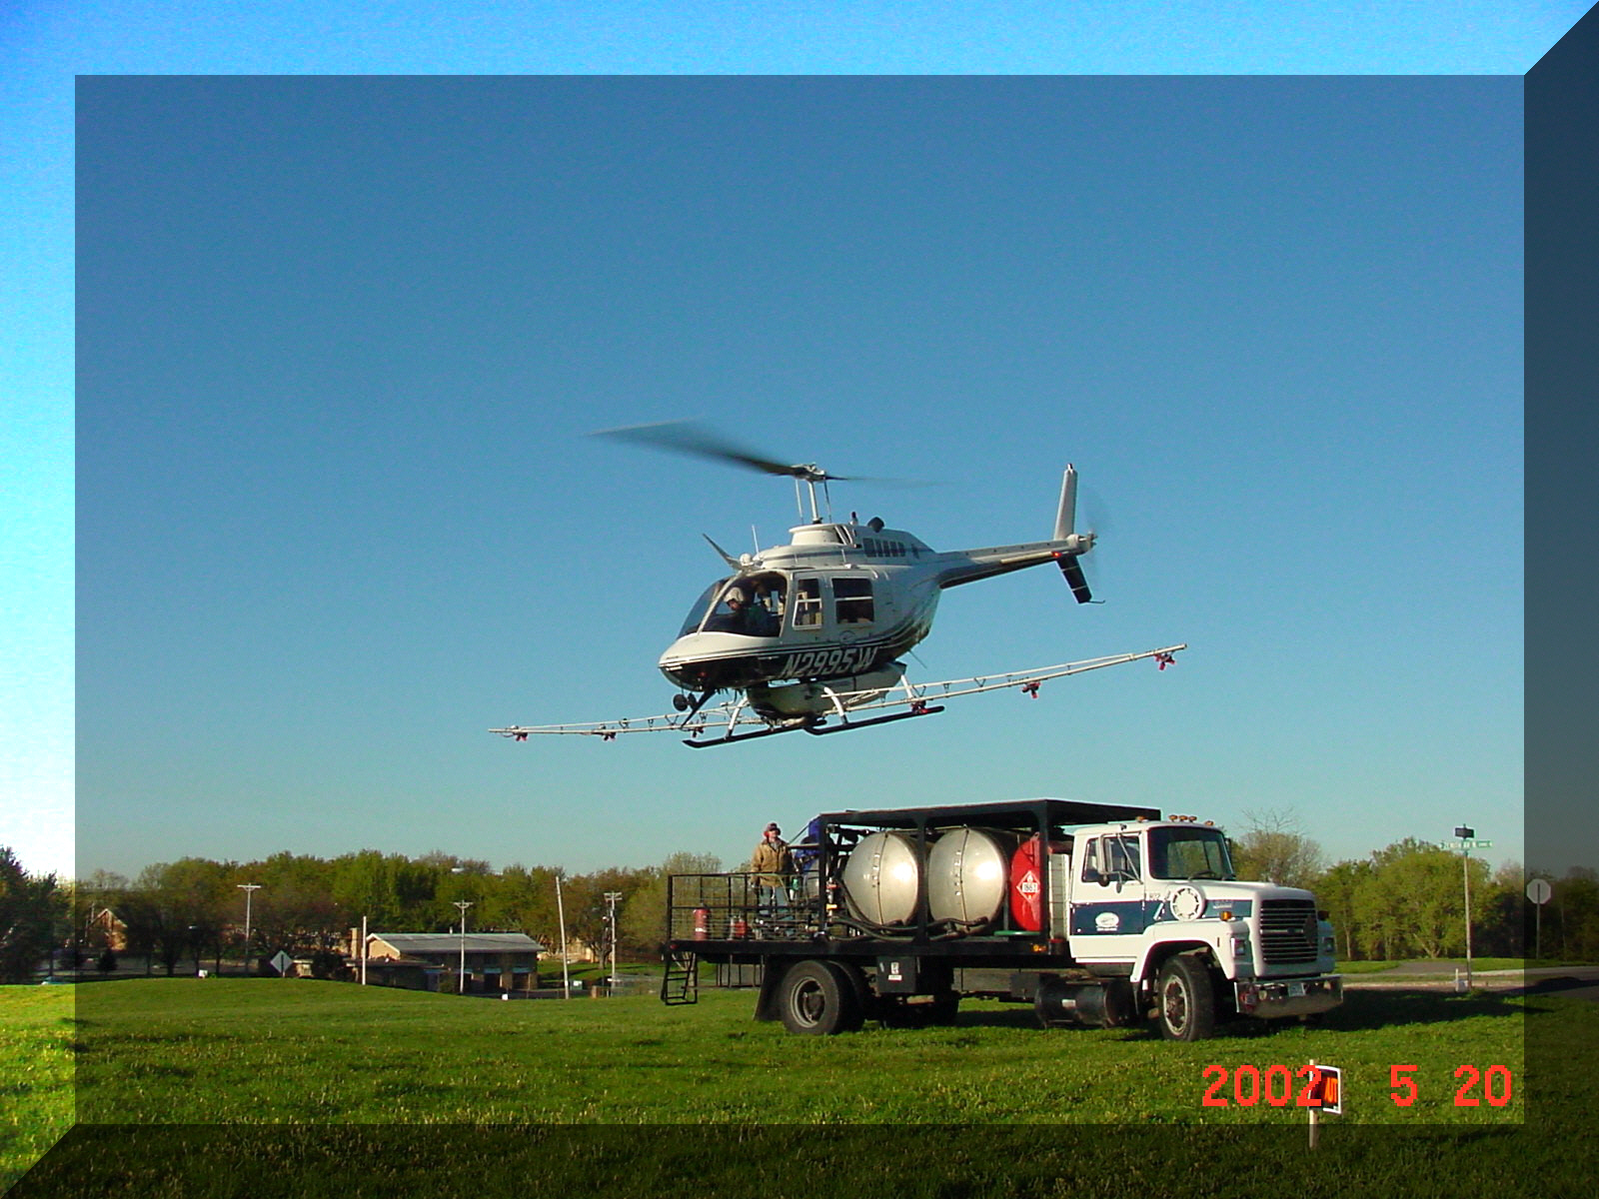
Foliage Treatments
(Low Volume)
Aerial applications
Low volume
Not as selective by
placement
http://www.scottshelicopter.com

Slide 33
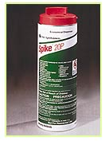
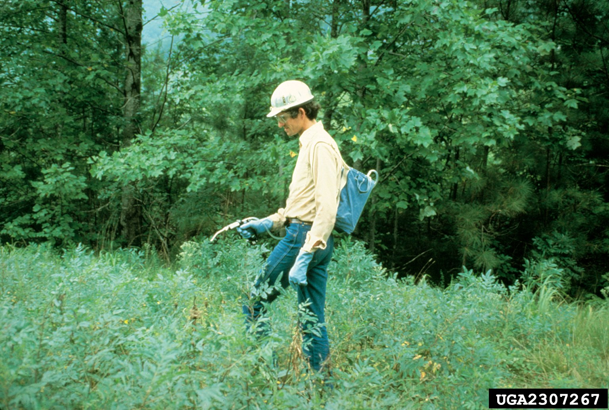
Soil Treatments
Root Uptake
Use caution near
desirable vegetation
www.chem-trol.com
Dry materials
http://dnr.state.il.us
Low volume spot gun
Notes:
Granular applications for hard to reach areas.

