Slide 1
Herbicide Product Summaries
Category 10

Slide 2
Table 1, page 1
Trade Name | Common Name (Active Ingredient) | Manufacturer
Acclaim Extra | Fenoxaprop-P-ethyl | Bayer
Accord Concentrate | Glyphosate | Dow AgroSciences
Aquaneat | Glyphosate | NuFarm Specialty Products
Arsenal AC | Imazapyr | BASF

Slide 3
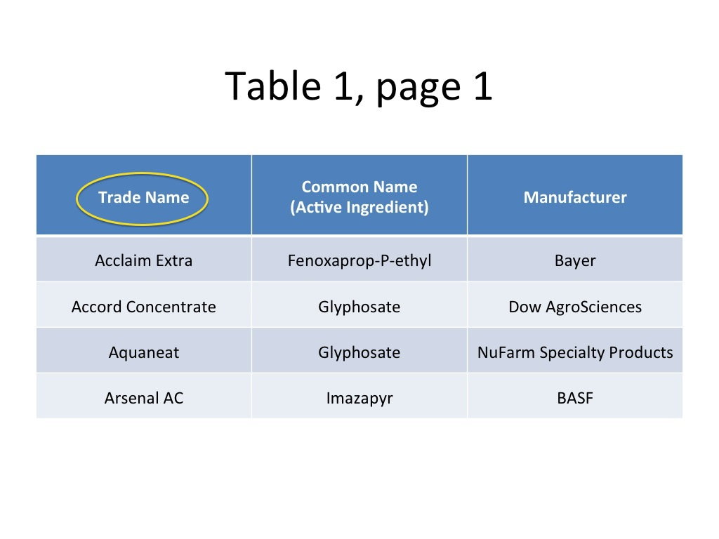

Slide 4
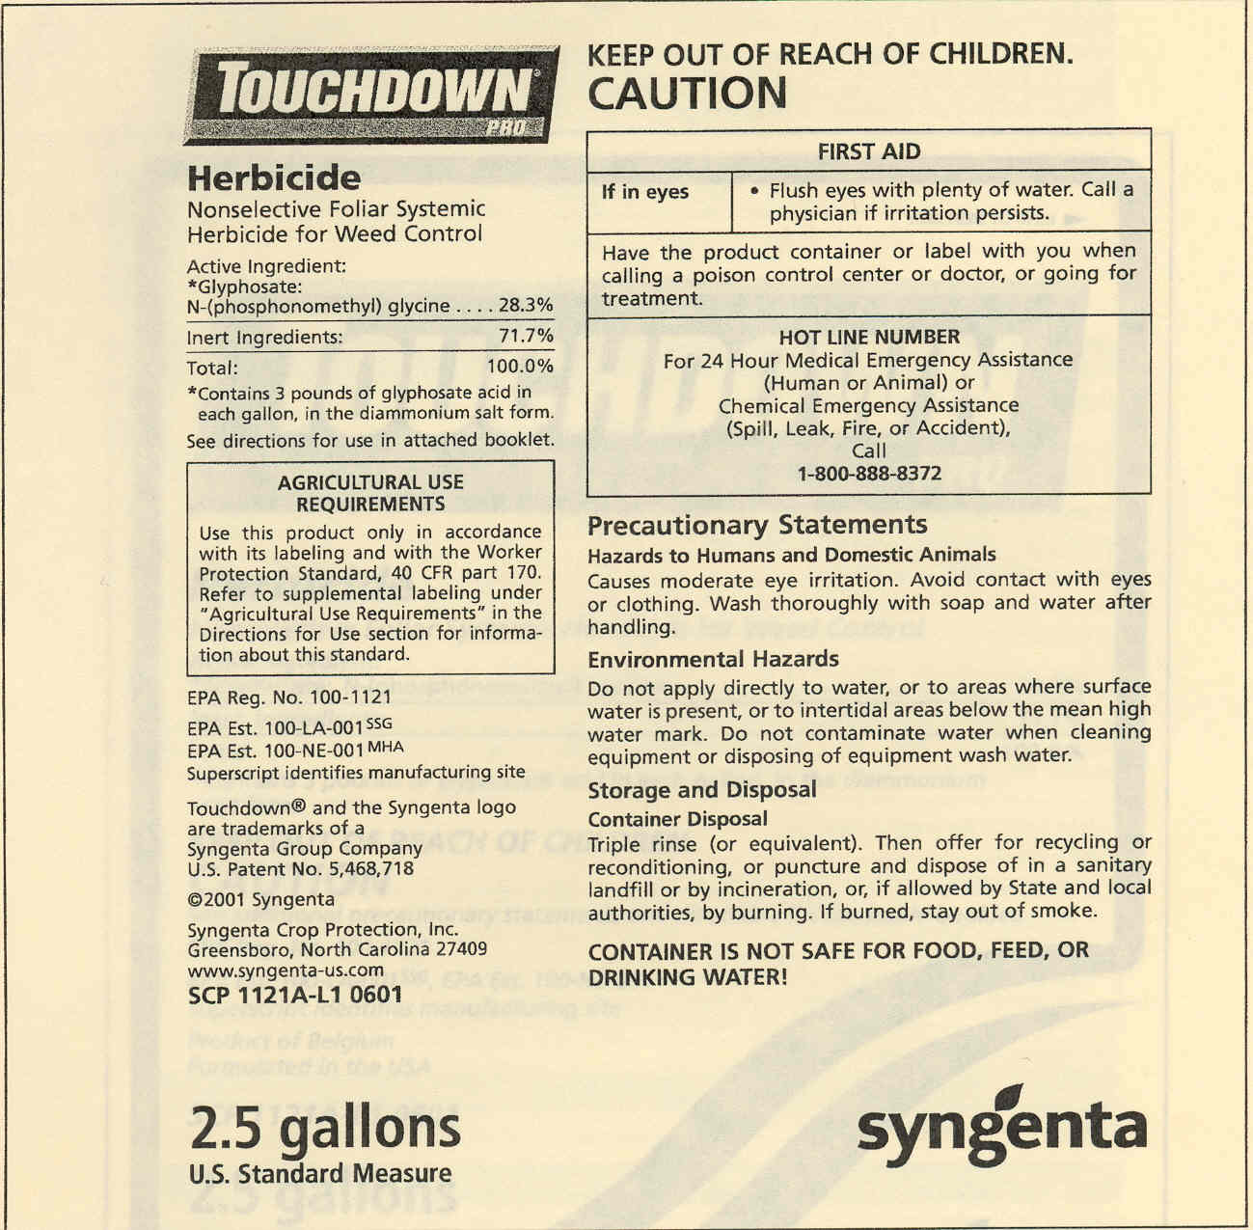
Trade Name
Review
Notes:
Sometimes the amount of information on the label can be over whelming,
Lets do a quick review
The trade name is an unique name used to advertise the product. (Also known as brand or product name.)

Slide 5
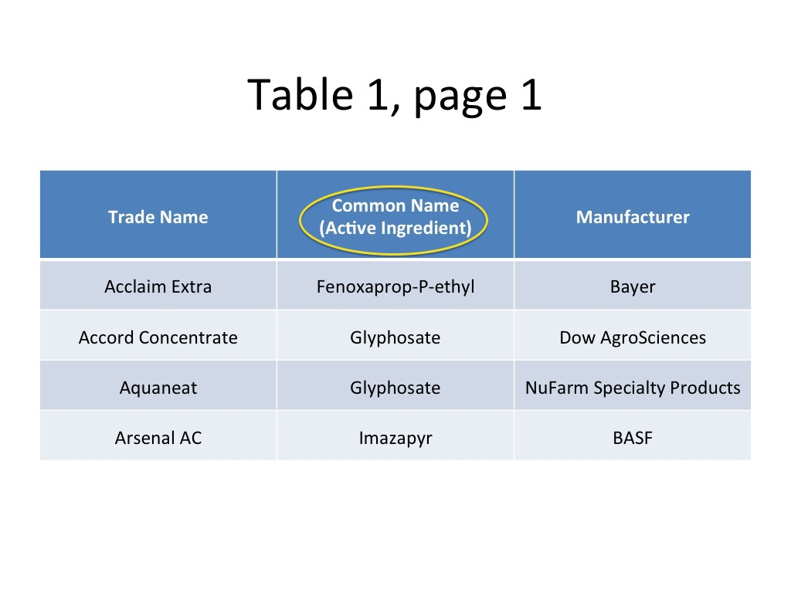

Slide 6
Ingredient
Statement
Review
Notes:
Tells what is in the product and list each active ingredient individually and the percentage of the product that it makes up.

Slide 7
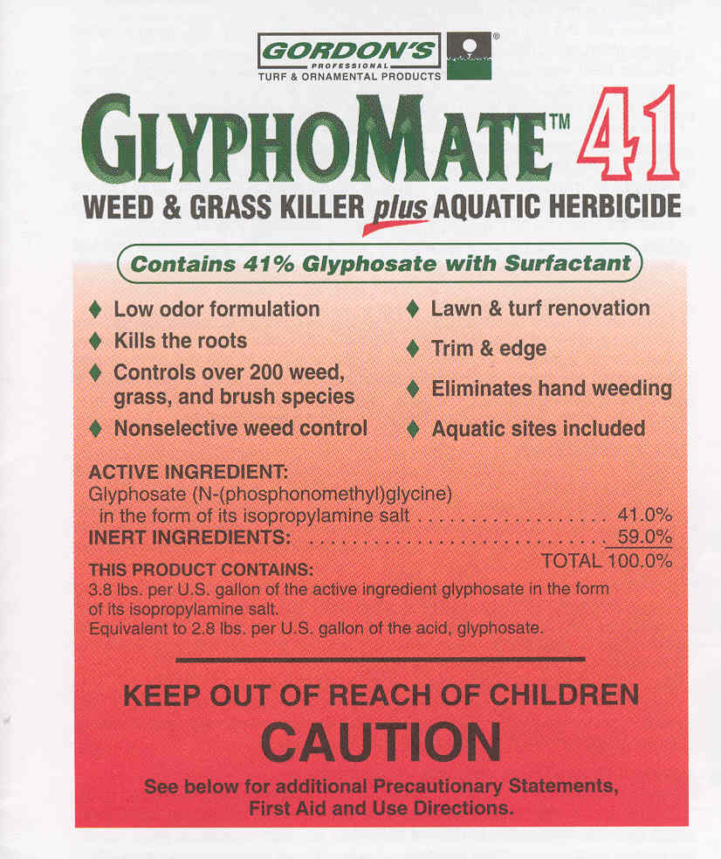
Active Ingredients
Official common name is usually followed by the chemical name in the list of active ingredients
Notes:
Official common name is usually followed by the chemical name in the list of active ingredients .
Common Name—A simpler name given by the Environmental Protection Agency (EPA) to a chemical name for easier recognition.
Chemical Name—The complex name identifying the chemical components and structure of a chemical.

Slide 8
Ingredient Statement
Active Ingredients -
  The part of the product that
  actually controls the pest(s)
Notes:
The Active ingredient is the part of the product that is actually killing or in some way controlling the pest.

Slide 9
Ingredient Statement
Active Ingredient -
  Each active ingredient must
be listed by individual
percentage
Notes:
Active Ingredient—The chemical(s) responsible for controlling the pest. Individually listed on the label by its common name and/or the chemical name and its percentage in the product.

Slide 10
Ingredient Statement
Inert Ingredients -
  Listed as total percentage
  in the product
Notes:
Inert ingredients are those that are not actively controlling the pest. These ingredients my make the product easier to mix or apply, or they may make the product more effective, but alone they do not control the pest.
Inert ingredients don’t need to be listed individually, but must be listed as their entire percentage of the product.

Slide 11
Ingredient Statement
Inert Ingredients -
  Listed as total percentage
  in the product
Notes:
Inert ingredients are those that are not actively controlling the pest. These ingredients my make the product easier to mix or apply, or they may make the product more effective, but alone they do not control the pest.
Inert ingredients don’t need to be listed individually, but must be listed as their entire percentage of the product.

Slide 12
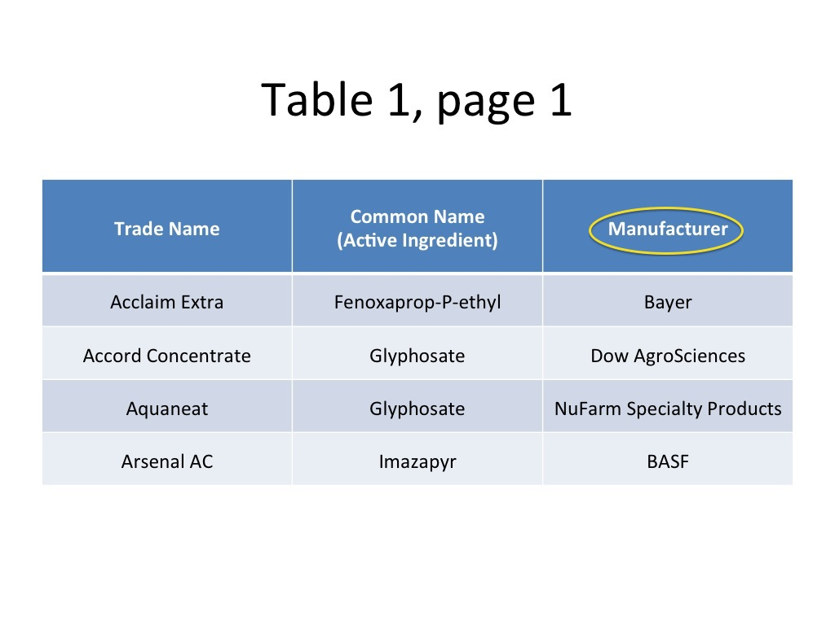

Slide 13
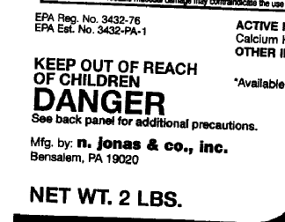
Name and Address of Manufacturer
The law requires the manufacturer or formulator of a product to put the name and address on the label

Slide 14
Table 2, page 3
Common Name (Active Ingredient) | Trade Name | Manufacturer
2,4-D | DMA 4 IVM | Dow AgroSciences
Aminopyralid | Milestone VM | Dow AgroSciences
Bentazon | Basagran T/O | BASF
Bromacil | Hyvar X | DuPont

Slide 15
Table 3, page 5
Trade Name | Common Name (Active Ingredient) | Signal Word | Acute Oral LD50 (Rat) (mg/kg) | Acute Dermal LD50 (Rabbit) (mg/kg) | 4-hour Inhalation LC50 (Rat) (mg/L)
Acclaim Extra | Fenoxaprop-P-ethyl | Caution | >5,000 | >4,000³ | >10.7
Accord Concentrate | Glyphosate | Caution | >5,000 | >5,000 | >6.37
Aquaneat | Glyphosate | Caution | >5,000 | >5,000 | >4.24
Arsenal AC | Imazapyr | Caution | >5,000 | >5,000 | 4.62

Slide 16
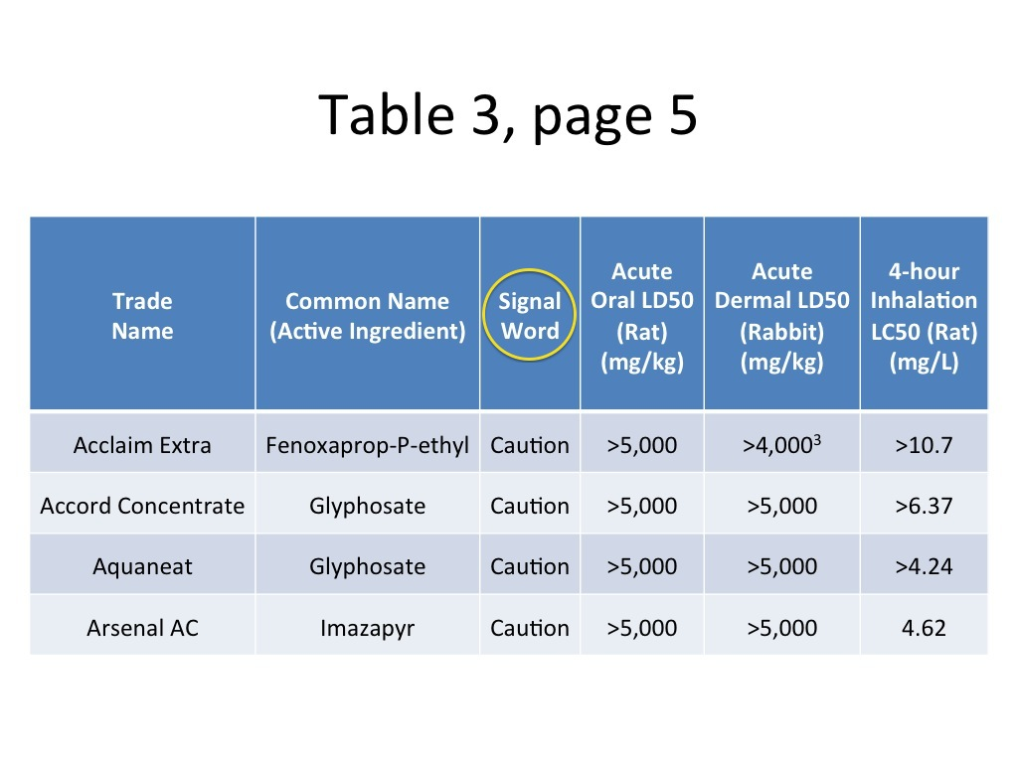

Slide 17
Signal Word
Review
Notes:
The word on the label that tells the potential hazards of the product

Slide 18

Signal Words and Symbols
Indicates the acute toxicity to humans and animals
Includes statement “Keep Out of Reach of Children”

Slide 19
Signal Words and Symbols
DANGER-POISON with a skull-and-crossbones symbol
Peligro (Spanish for “danger” must also appear on the label
Indicates product is highly toxic by any route of entry

Slide 20
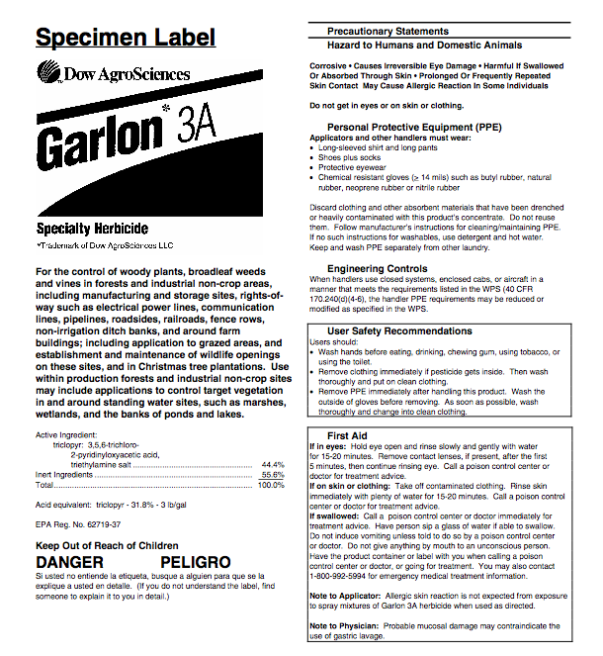
Signal Words and Symbols
DANGER
Products with this signal word can cause severe eye damage or skin irritation
Tells nothing about toxicity

Slide 21
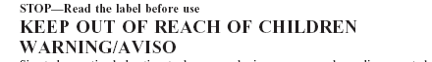
Signal Words
WARNING
  Product is moderately toxic
  Aviso (Spanish for “warning”
  must also appear on the label)
Notes:
Warning as a signal word means that the product is Moderately Toxic either orally, dermally, or through inhalation; and may causes moderate eye or skin irritation.
Aviso, the Spanish word for warning, must also appear on the label.

Slide 22
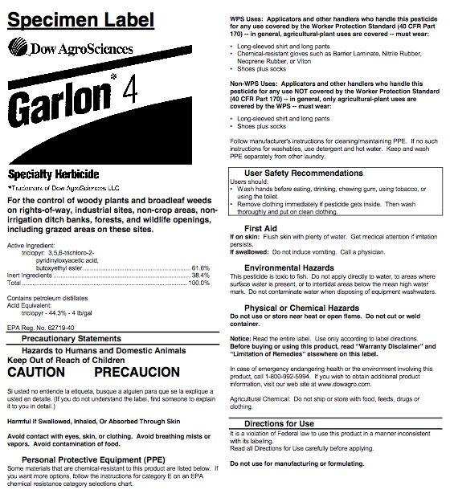
Signal Words
CAUTION
  Product is slightly toxic
  may cause eye or skin irritation
Notes:
A caution signal word tells the applicator that the product is Slightly Toxic either orally, dermally, or through inhalation; or may causes slight eye or skin irritation.

Slide 23


Slide 24


Slide 25
Toxicity
A measure of a pesticides capacity to cause injury or illness.
  Dependent upon:
    Properties of the chemical.
    Your risk of exposure to harmful amounts
Exposure:
  Ingestion (oral) – absorption by intestinal tract
  Inhalation – breathing vapors, spray droplets, or dust
  Dermal – absorption through skin
  Eye Contact – absorption through eye tissue
Notes:
Pesticides need to be biologically active, or toxic, to be effective against the pests they are intended to control
Toxicity is a pesticides ability to cause injury or illness
Risk of exposure to harmful amounts
Exposure is based upon oral, dermal, or inhalation routes - Four ways that pesticides can enter the body

Slide 26
Toxicity
  Acute Toxicity Expressed as:
  LD50 - lethal dose 50 or
  LC50 - lethal concentration 50
    The dosage lethal to 50% of a test population of animals under a standard set of conditions.
    Recorded in:
      Mg of pesticide per Kg of body weight (mg / kg)
      Mg of pesticide per volume of air or water (ppm)
  Basis for assigning the “Signal Word”
Notes:
LD 50 is the amount or concentration required to kill 50% of the test population of animals under a standard set of conditions.
The lower the LD50 value: the greater the acute toxicity - the less of the herbicide it will take to kill 50% of the population and therefore,
LC 50 values are recorded as milligrams of pesticide per volume of air or water in parts per million (ppm)
Acute toxicities are the basis for assigning pesticides to a toxicity category and selecting the appropriate signal word.

Slide 27
Signal Words
Every pesticide label must include a “signal word”
as well as the words:
“KEEP OUT OF REACH OF CHILDREN”
Caution – slightly toxic or practically nontoxic
    LD50 > 500 mg/kg
Warning – moderately toxic
    LD50 = 50 – 500 mg/kg
Danger – causes severe eye or skin irritation
Danger/Poison (skull and crossbones) – highly toxic
    LD50 = trace to 50 mg/kg
Notes:
Signal words give the user an indication of the relative acute toxicity of the product to humans and animals
Signal word is also based on the amount of eye damage or skin irritation caused.
If two products control the same pest, signal words allow the user to select the least toxic chemical that will give the desired level of pest control

Slide 28
Relative Toxicity of Commonly Used Forestry Herbicides
Trade Name | Active Ingredient | Signal Word | Toxicity (LD 50)
Accord Concentrate | glyphosate | Caution | >5000
Arsenal AC | imazypyr | Caution | >5000
Escort XP | metsulfuron methyl | Caution | >5000
Garlon 4 | triclopyr | Caution | 1338
Krenite S | Fosamine | Caution | >5000
Oust XP | sulfometuron methyl | Caution | >5000
Tordon K | picloram | Caution | >5000
Velpar ULW | hexazinone | Danger | 1310
Compare to: | Sodium chloride (salt) |  | 3000
 | Tylenol (acetometaphin) |  | 1944
 | Motrin (Ibuprofen) |  | 636
 | Malathion |  | 290
 | Sevin (carbaryl ) |  | 230
 | Caffeine |  | 192
Notes:
> 5000 indicates that the product is practically nontoxic

Slide 29
Forestry Herbicide’s
Mode of Action
How can products with such low toxicities be so effective at killing plants?
Forestry herbicides work on
biochemical pathways that
are specific to plants.
Ex. Glyphosate
Inhibits the production of EPSP Synthase,
Necessary for the production of 3 amino acids.
Notes:
REFER TO HANDOUTS FOR GARLON AND ACCORD
- For example, only plants photosynthesize, so if a compound inhibits one or several of the steps in the long biochemical pathway that is photosynthesis, that compound is then toxic to plants. At the same time, that compound may have no effect on animal systems because the same biochemical pathway does not exist.
- Some herbicides work on amino acid pathways that are specific to plants and not found in animals. All of these types of compounds can be very effective herbicides yet are safe for animals because the same biochemical basis for toxicity does not exist
- Ex. Glyphosate: The 3 amino acids are essential for protein synthesis. As protein production stops, the plant begins to die. This metabolic pathway is only found in plants. Also inhibits chlorophyll synthesis.

Slide 30
Personal Protective Equipment
Consider the “signal word”
Greatest risk arises when handling concentrates – ie. mixing or loading
All forestry herbicides require: long sleeved shirt, long pants, shoes plus socks
Additional requirements: chemical resistant gloves, eyewear
  Mixers: coveralls or chemical resistant apron
Notes:
What kind of PPE do you need to wear when applying forestry herbicides
- Personal Protective Equipment

Slide 31
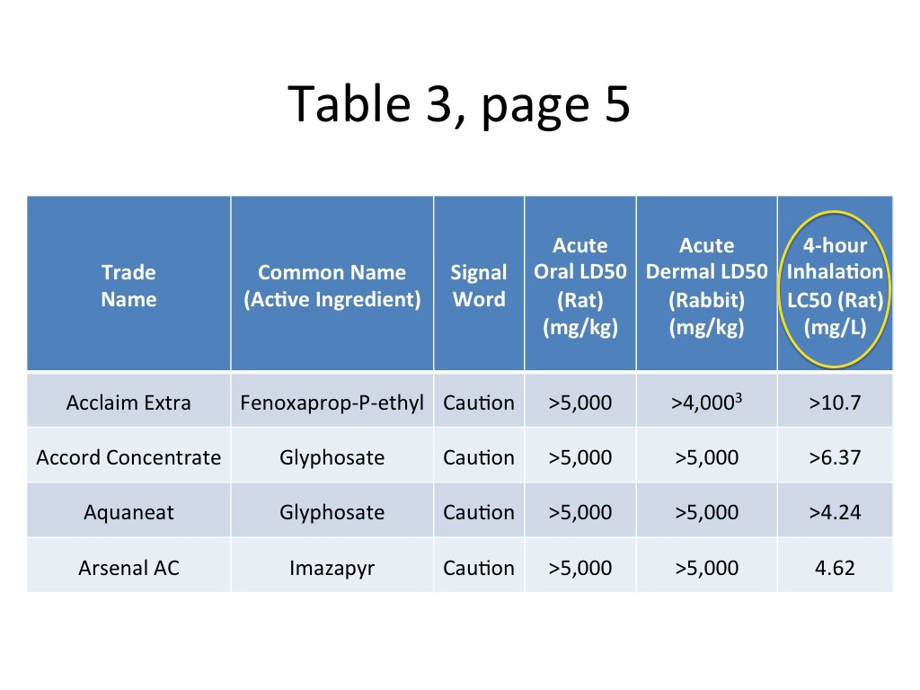

Slide 32
Arsenal AC, Arsenal Powerline, Chopper, Habitat, Stalker
(imazapyr)
Producer: BASF
Signal Word: Caution
Application Rate: 0.031 to 1.5 lb ai/acre
Formulation per/acre
2S 2 oz to 6 pt
4S 4 to 40 oz
2EC 1 to 3 pt

Slide 33
Arsenal AC, Arsenal Powerline, Chopper, Habitat, Stalker
(imazapyr)
Several manufacturers offer 2 S formulations of imazapyr for non-crop and/or aquatic applications. The 4 S formulations are used primarily in forestry.

Slide 34
Arsenal AC, Arsenal Powerline, Chopper, Habitat, Stalker
(imazapyr)
Mode of Action:
Systemic. Translocates throughout the plant. Entry through foliage, stems, or roots. Can be applied pre- or postemergence to plant or soil.
Imazapyr binds to and inactivates the enzyme acetolactase synthase (ALS), preventing synthesis of essential amino acids. Affected plants cease growth quickly, but complete control of treated plants may take several weeks.

Slide 35
Arsenal AC, Arsenal Powerline, Chopper, Habitat, Stalker
(imazapyr)
Selectivity: Non-selective, except conifers generally resistant.
Minimum Personal Protective Equipment: Long-sleeved shirt, long pants, shoes, socks, and chemical-resistant gloves.
Sites: Habitat is labeled for aquatic sites. Other products are appropriate for terrestrial applications only and cannot be applied directly to water.

Slide 36
Arsenal AC, Arsenal Powerline, Chopper, Habitat, Stalker
(imazapyr)
Uses:
Herbaceous weed control, total vegetation control, foliar brush control, cut surface, frill girdle, stem injection, basal bark, seed head suppression of unimproved Bermudagrass and cool-season turfgrasses, weed control under paved surfaces, aquatic weed control.

Slide 37
Arsenal AC, Arsenal Powerline, Chopper, Habitat, Stalker
(imazapyr)
Notes:
Efficacy is largely determined by application rate. Legumes tend to be more tolerant than other plant species. Higher application rates provide persistent soil activity, so use caution when applying near the roots of desirable plants. Due to the relatively slow nature of activity, tank mixing with fast acting herbicides such as 2,4-D is not recommended. Biotypes of kochia (Kochia scoparia) have been found to be resistant to imazapyr and other ALS-inhibiting herbicides.

Slide 38
Arsenal AC, Arsenal Powerline, Chopper, Habitat, Stalker
(imazapyr)
Combination Products:
  Sahara DG (62% diuron, 8% imazapyr). Pre- or postemergence to maintain bare ground on industrial sites and weed control under paved surfaces.
  Viewpoint [62DG] (32% imazapyr, 23% aminocyclopyrachlor, 7.3% metsulfuron). Viewpoint provides preemergence and/or postemergence control of many broadleaf weeds, vines, and brush species.

Slide 39
Garlon 4, Pathfinder II, Tahoe 4E
(triclopyr)
Producer: Dow AgroSciences, Nufarm
Signal Word: Caution
Application Rate: 0.75 to 9.0 lb ae/acre
Formulation per/acre
4 EC 1 qt to 2 gal
0.75 RTU ready-to-use

Slide 40
Garlon 4, Pathfinder II, Tahoe 4E
(triclopyr)
Mode of Action:
Systemic. Translocates throughout the plant. Readily taken up by foliage. Ester formulations penetrate bark.
Triclopyr acts on the platn in a manner similar to 2,4-D, mimickig the activity of the plant hormone auxin. Regulation of growth is severely disturbed and actively growing tissue becomes malformed, with symptoms such as leaf curling and stem twisting. Triclopyr is only active on broadleaf species.

Slide 41
Garlon 4, Pathfinder II, Tahoe 4E
(triclopyr)
Selectivity: Selective. Controls broadleaf weeds and brush.
Minimum Personal Protective Equipment: Long-sleeved shirt, long pants, shoes, socks, and chemical-resistant gloves, such as:
butyl rubber ≥ 14 mils,
natural rubber ≥ 14 mils,
neoprene rubber ≥ 14 mils, or
nitrile rubber ≥ 14 mils.
Sites: Terrestrial use only. Do not apply near water or ditches used to transport irrigation water.

Slide 42
Garlon 4, Pathfinder II, Tahoe 4E
(triclopyr)
Uses:
Selective broadleaf weed control, control of brush with foliar, basal bark, and cut stump surface.

Slide 43
Garlon 4, Pathfinder II, Tahoe 4E
(triclopyr)
Notes:
Triclopyr has very little soil activity and must be applied directly to the target plant. Dormant season basal bark applications are effective on treated stems but have limited effect on the root system of suckering tree species such as sumac, tree-of-heaven, black locust, or sassafras.

Slide 44
Garlon 4, Pathfinder II, Tahoe 4E
(triclopyr)
Combination Products:
  Milestone VM Plus [1.1 S] (12% triclopyr, 1.2% aminopyralid).

Slide 45

This presentation was developed by the Pesticide Education Program.
Use of this presentation or parts of this presentation is encouraged as long as this credit slide is included.
Graphics in this presentation courtesy of :
Lowe’s Companies Inc.
Pennsylvania Agromedicine Program
Penn State Pesticide Education Program
National Pesticide Information Retrieval System
“Penn State is committed to affirmative action, equal opportunity, and the diversity of its workforce.”
© The Pennsylvania State University 2005 November 10, 2005

Slide 46
Review Questions

Slide 47
Which of the following products is a “restricted use pesticide”?
Surflan AS
Tordon K
Pramitol 25 E
Hyvar X
Oust XP
Notes:
Gramoxone Inteon (paraquat) is another RUP.

Slide 48
The active ingredient “imazapic” is sold under what trade name?
Assure II
Plateau
Garlon 3A
Panoramic 2SL
B and D
Notes:
Gramoxone Inteon (paraquat) is another RUP.

Slide 49
Which product carries a “danger” signal word?
Hyvar X
Pendulum Aquacap
Spike 20 P
Garlon 3A
Garlon 4
Notes:
Gramoxone Inteon (paraquat) is another RUP.

Slide 50
Among the products contained in the “Herbicide Product Summaries” which has the greatest toxicity from oral uptake?
Reward
Surflan AS
Vanquish
Roundup Pro
Gramoxone Inteon

Slide 51
Which product can be applied to aquatic sites?
Arsenal AC
Arsenal Powerline
Chopper
Habitat
Stalker

Slide 52
Which product is NOT systemic?
Rodeo
Vista
Reward
Acclaim Extra
Tahoe 3A

Slide 53
Which product has the longest soil activity (residual)?
DMA 4 IVM
Reward
Karmex
Roundup Pro
Garlon 3A

Slide 54
Which product is used as a postemergent to control only grasses?
Finale
Assure II
Hyvar X-L
Pendulum Aquacap
Tahoe 3A

Slide 55
Which product would be safe around the roots of desirable trees?
Hyvar X
Oust XP
Pennant Magnum
Tordon K
Velpar DF

Slide 56
Which product(s) is used to inhibit seed heads in grasses?
Embark 2S IVM
Assure II
Basagran T/O
A & B
B & C

Slide 57
Which product(s) can be used for treating cut stumps?
Milestone VM
Garlon 4
Pathfinder II
A & B
B & C

