Slide 1
Invasive Weed Fact Sheets

Slide 2
Invasive Weed Information Guide
Common Name | Scientific Name | Life Cycle | Taxonomy | Methods of Dispersal | Habitat | PA Noxious Weed | Fact Sheet | Found in Roadside Weeds
Autumn Olive | Elaeagnus umbellata | Perennial | Woody Broadleaf shrub | Seeds | Highly Adaptable | No | No | Yes
Black Locust | Robinia pseudoacacia | Perennial | Woody Broadleaf tree | Seeds and Root Sprouts | Highly Adaptable | No | No | Yes
Boxelder | Acer negundo | Perennial | Woody Broadleaf tree | Seeds | Bottomlands, Adaptable | No | No | Yes
Bull thistle | Cirsium vulgare | Biennial | Herbaceous Broadleaf | Seed | Adaptable | Yes | No | Yes
Canada thistle | Cirsium arvense | Perennial | Herbaceous Broadleaf | Seed and Rhizomes | Adaptable | Yes | Yes | Yes
Exotic shrub honeysuckles | Lonicera spp. | Perennial | Woody Broadleaf shrub | Seeds | Adaptable | No | No | Yes
Garlic mustard | Alliaria petiolata | Biennial | Herbaceous Broadleaf | Seed | Moist, shaded sites | No | Yes | No
Giant Knotweed | Polygonum sachalinense | Perennial | Herbaceous Broadleaf | Rhizomes | Highly Adaptable | No | Yes | Yes
Japanese Barberry | Berberis thunbergii | Perennial | Woody Broadleaf shrub | Seeds and Root Sprouts | Adaptable | No | Yes | No
Japanese knoweed | Polygonum cuspidatum | Perennial | Herbaceous Broadleaf | Rhizomes | Highly Adaptable | No | Yes | Yes
Japenese Stiltgrass | Microstegium vimineum | Annual | Grass | Seed | Adaptable | No | Yes | No
Kochia | Kochia scoparia | Annual | Broadleaf | Seed | Dry Sites | No | No | Yes
Mile-a-minute | Polygonum perfoliatum | Annual | Broadleaf Vine | Seed | Adaptable | Yes | Yes | Yes
Multiflora rose | Rosa multiflora | Perennial | Woody Braadleaf shrub | Seeds and Layering | Adaptable | Yes | No | Yes
Musk thistle | Carduus nutans | Biennial | Herbaceous Broadleaf | Seed | Adaptable | Yes | No | Yes
Oriental bittersweet | Celastrus orbiculatus | Perennial | Woody Broadleaf vine | Seeds and Root Sprouts | Adaptable | No | No | Yes
Plumeless thistle | Carduus acanthoides | Biennial | Herbaceous Broadleaf | Seed | Adaptable | No | No | Yes
Poison hemlock | Conium maculatum | Biennial | Herbaceous Broadleaf | Seed | Adaptable | No | No | Yes
Poison ivy | Toxicodendron radicans | Perennial | Woody Broadleaf vine | Seeds | Adaptable | No | No | Yes
Purple loosestrife | Llythrum salicaria | Perennial | Herbaceous Broadleaf | Seed | Wetlands, Seaaonally Wet Sites | Yes | Yes | Yes
Reed canary-grass | Phalaris arundinacea | Perennial | Grass | Seed and Rhizomes | Wetlands, Moist areas | No | Yes | No
Spotted knapweed | Centaurea stoebe | Biennial or S. L. perennial | Herbaceous Broadleaf | Seed | Adaptable | No | Yes | No
Tree-of-heaven | Ailanthus altissima | Perennial | Woody Broadleaf tree | Seeds and Root Sprouts | Highly Adaptable | No | Yes | Yes
Wild parsnip | Pastinaca sativa | Biennial | Herbaceous Broadleaf | Seed | Adaptable | No | No | Yes

Slide 3
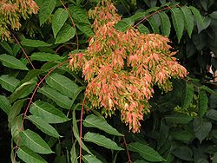
Tree of Heaven, Ailanthus altissima

Slide 4
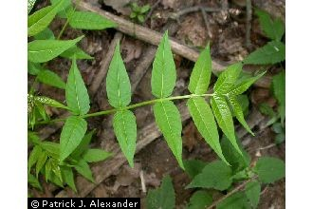
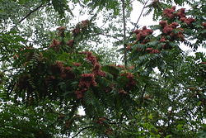
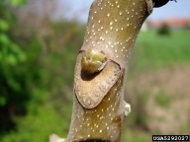
Tree of Heaven, Ailanthus altissima
Tall tree (50 to 75 feet)
Large pinnately compound leaves, with 11 to 41 leaflets, entire margins with glands at base
Unpleasant odor (stale peanut butter)
Light brown, slippery twigs
Clonal growth habit

Slide 5
Ailanthus Control
Chemical
Foliar Applications
Basal Bark Applications
Cut Surface Treatments
Mechanical
Cutting or Mowing
Cultural
Establish an Alternate Groundcover
Biological Don Davis at Penn State has be working on one

Slide 6
Ailanthus Control
Control Plan:
Foliar or Basal bark treatment
Cutting
Retreat sprouts
Establish competitive groundcover
If cut without treatment, excessive sproutung will occur

Slide 7
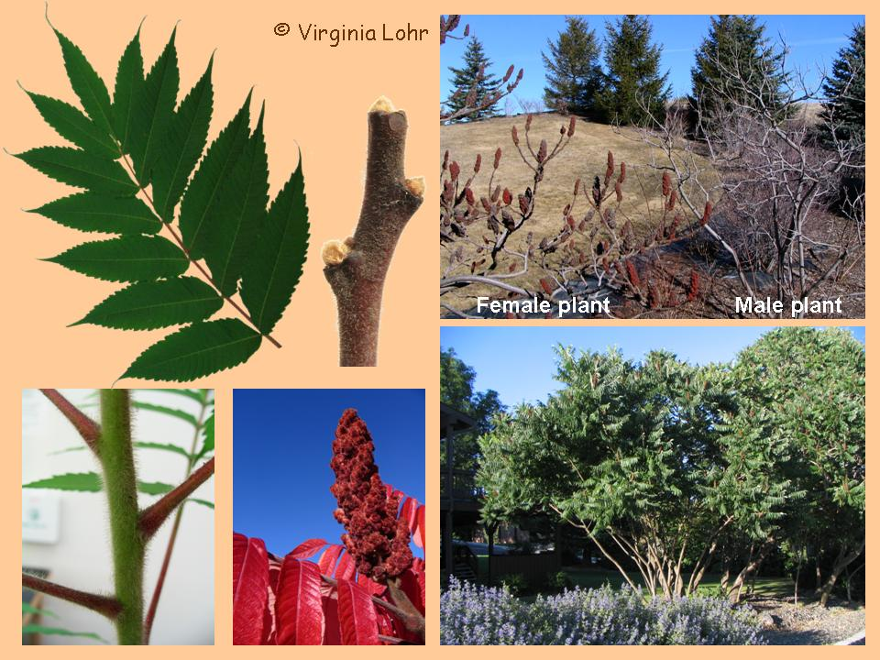
Staghorn Sumac
Tree of Heaven Look alike
Sumac
Notes:
Leaves and buds simlar to smooth sumac. Dioecious Hairy twig
Note: fruit cluster shrouded in fur A clonal clump
Look at your twig
Bud encircled by leaf scar

Slide 8
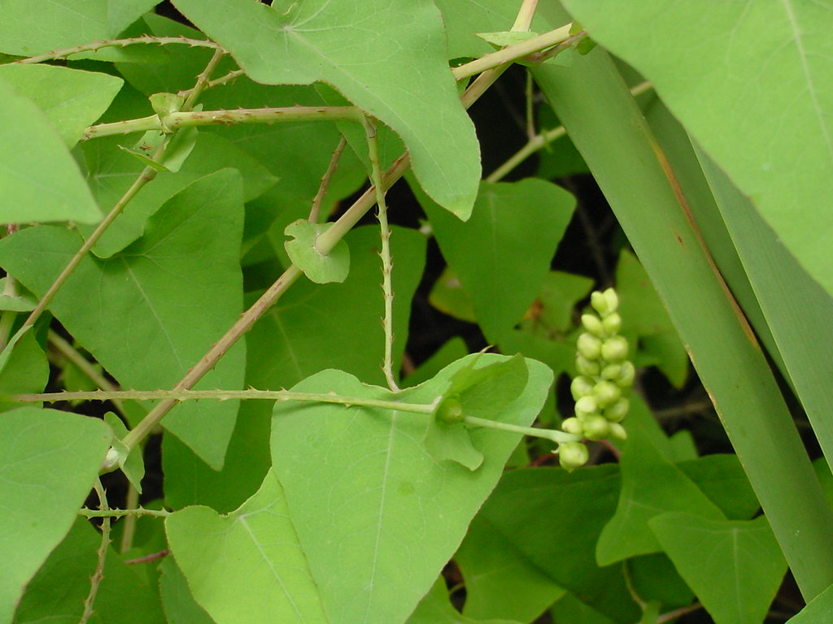
Mile-a-minute Polygonum perfoliatum

Slide 9
Mile-a-Minute
Annual Vine – very fast growing
Stem features downward pointing spines
Native to East Asia
Infests non-maintained areas – full sun to partial shade
Can begin to set seed by mid-July
PA noxious weed

Slide 10
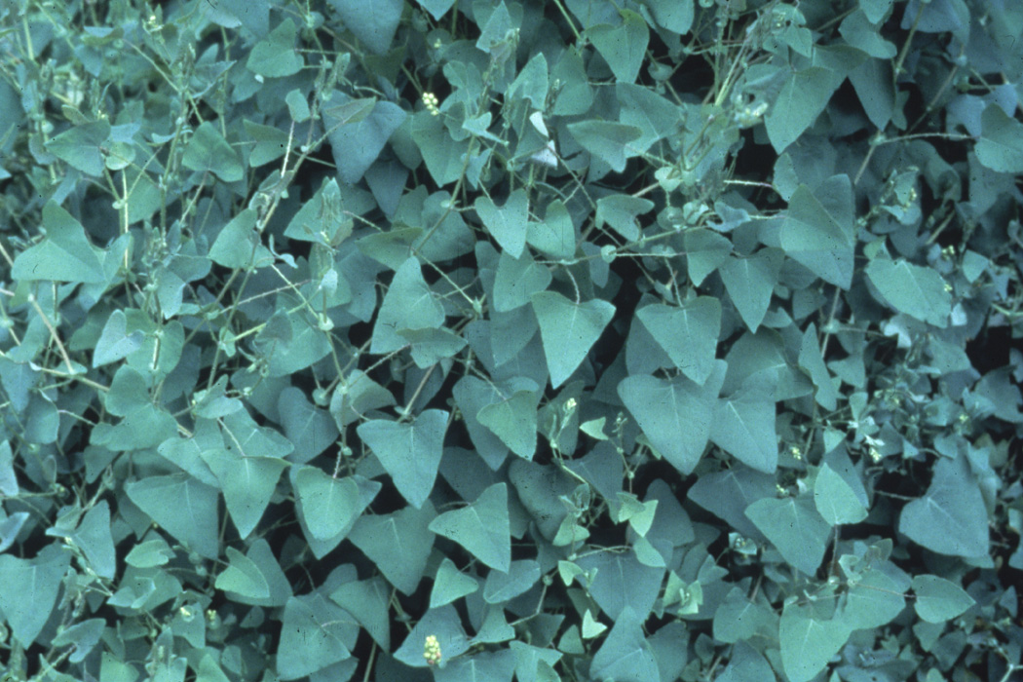
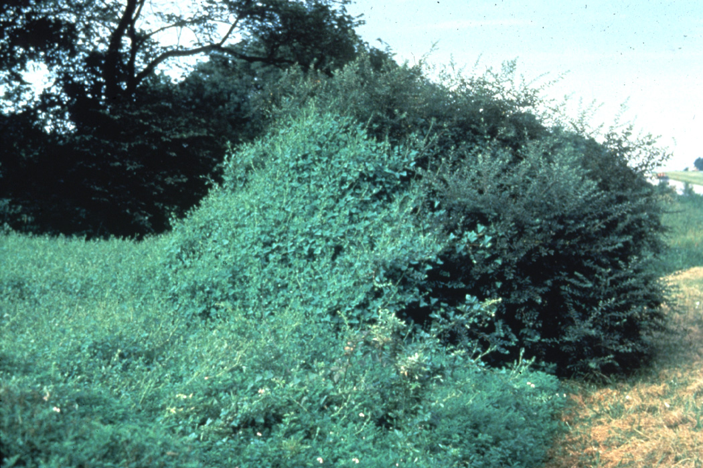
Mile-a-minute Polygonum perfoliatum
Rampant annual vine
Blue “Berries” are attractive to birds
Forest regeneration, grasslands, riparian areas

Slide 11
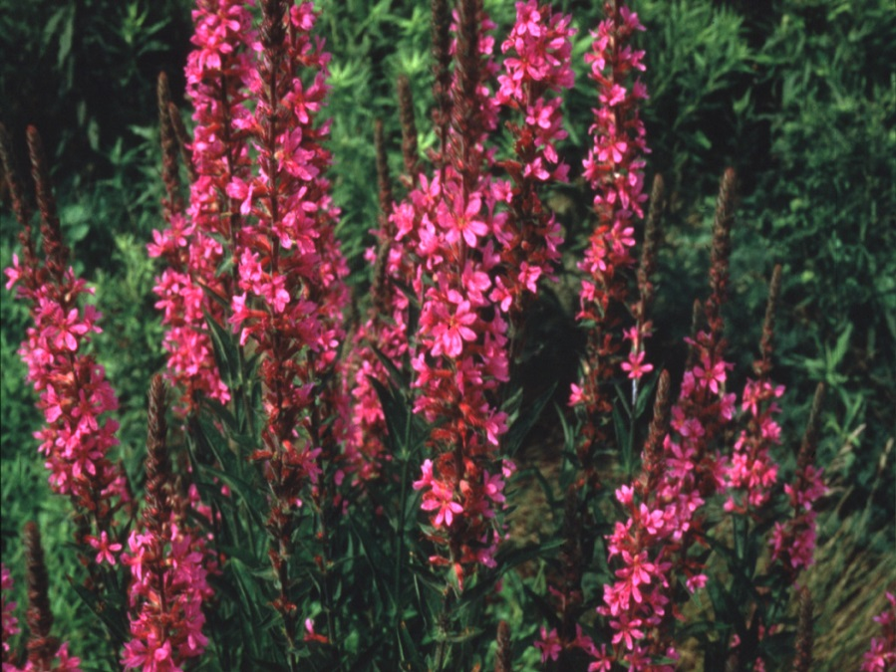
Purple Loosestrife Lythrum salicaria
Herbaceous perennial
PA Noxious Weed
Striking, long lasting blooms
Wetlands

Slide 13
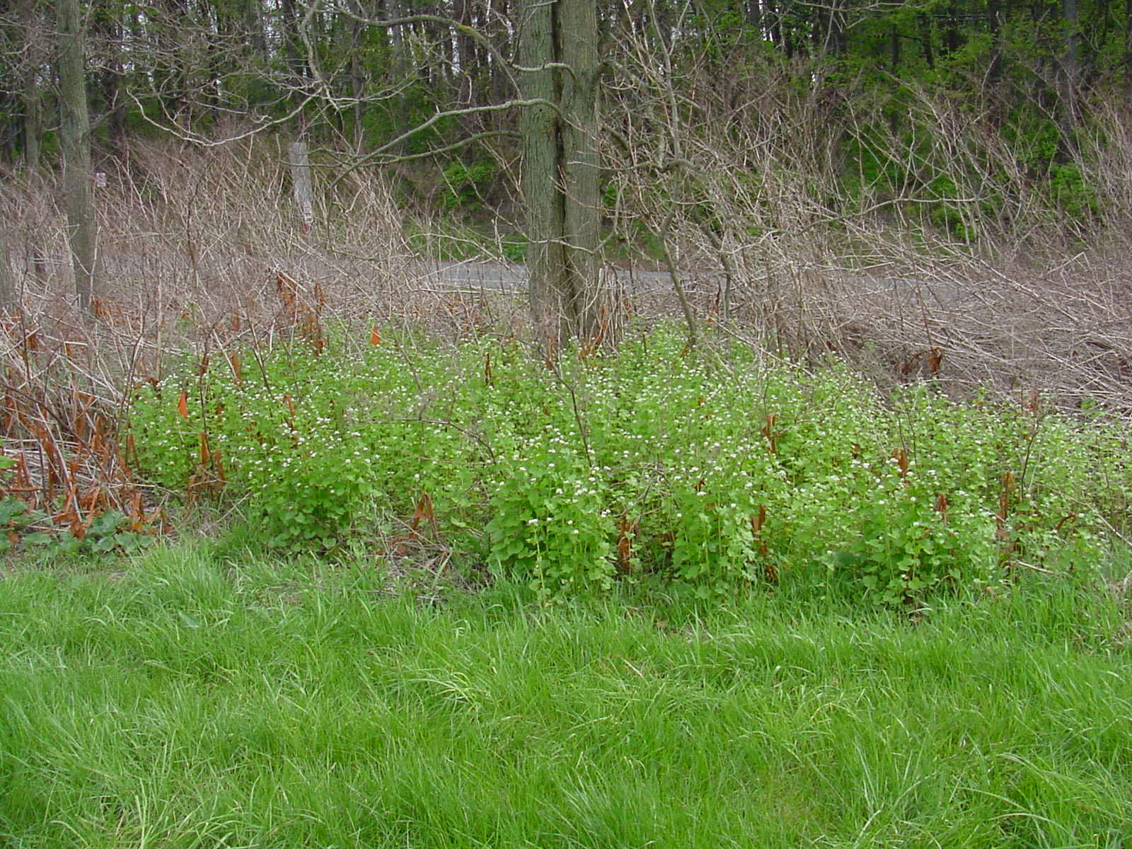
Garlic mustard Alliaria petiolata

Slide 14
Garlic mustard Alliaria petiolata
Cool season biennial herbaceous plant
(What is a biennial?)
First year rosettes remain green through the winter (What does this suggest for control ?)
Seeds produced early in the 2nd season (June)

Slide 15
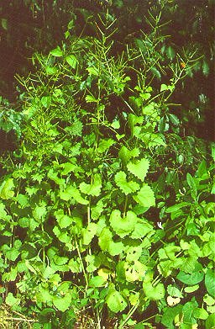
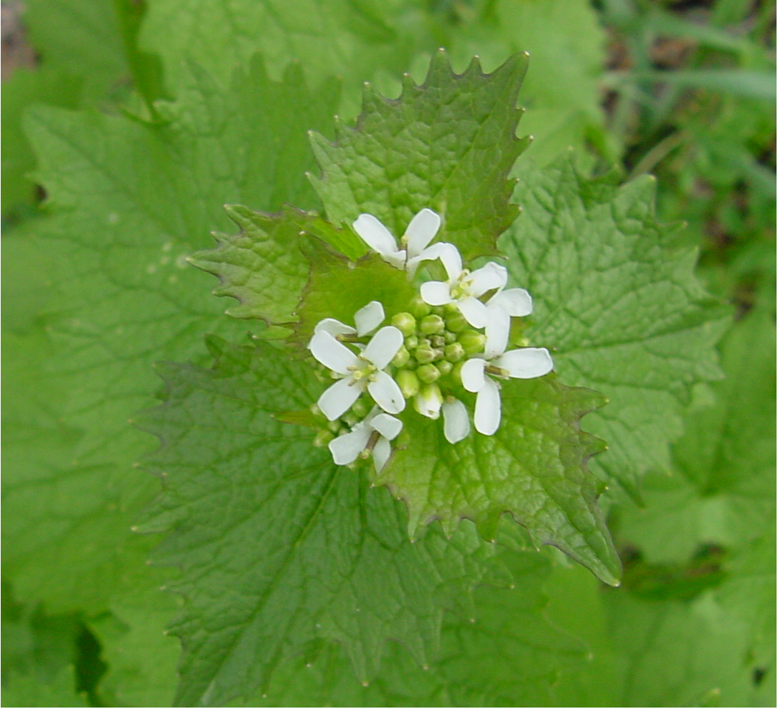
Garlic mustard Alliaria petiolata
Coarsely toothed leaves smell like garlic when crushed
Prefers moist, partially shaded sites
Introduced from Europe
The Nature Conservancy, tncweeds.ucdavis.edu

Slide 16
Kochia (Kochia scoparia)

Slide 17
Introduction Kochia
AKA fireweed, burning bush, summer cypress
Ornamental from Eurasia
Introduced around 1900 to U.S.

Slide 18
ID/Biology Kochia
Annual
Deep taproot
Erect, branched
3 to 7 ft. tall

Slide 19
ID/Biology Kochia
Alternate, simple leaves
Fuzzy or smooth
1 to 2 inches long
Flowers
Small, green
Clustered in axils of upper plant

Slide 20
ID/Biology Kochia
Seed dispersed in fall by tumbleweed
(14,600 seed/plant)

Slide 21
Issues Kochia
Low water requirements
High resistance to disease and insects
Competes for light, nutrients, moisture
Reduces crop yields in agriculture
Resistance to some herbicides

Slide 22
Japanese Knotweed
Vigorous rhizomes (underground stems) are the factor that makes this plant so challenging to control
Control:
Cut or spray early in season
Spray again in fall when carbohydrates are moving downward

Slide 23
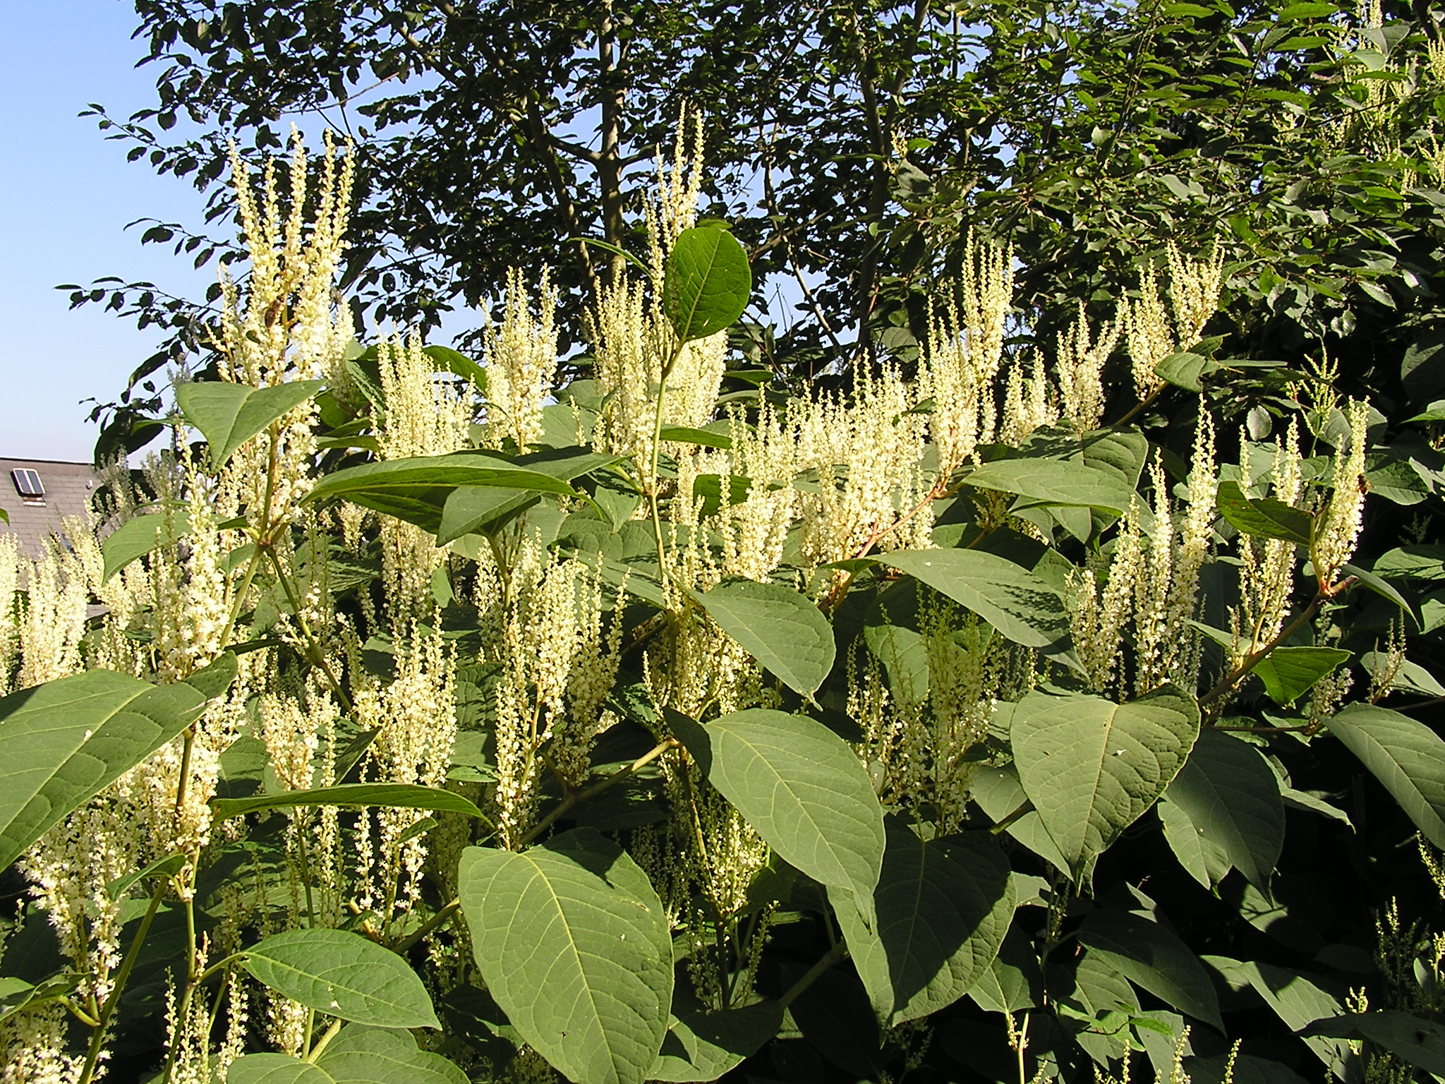
Japanese Knotweed
Tall Growing, hollow stemmed, perennial, herbaceous plant
Forms dense monocultures on a wide variety of sites

Slide 24
Grasses vs. Broadleaf Plants
Grasses:
Growing point just above ground level
Perform well as ground cover to compete with weeds and control erosion
Fibrous root system
Tolerate mowing (stem denstiy increases with mowing)

Slide 25
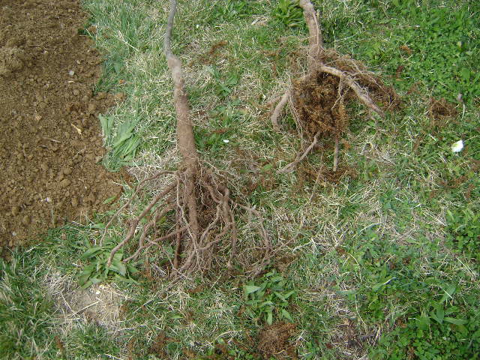
Grasses vs. Broadleaf Plants
Broadleaf plants:
Roots are larger and less fibrous. Think of bare rooting a tree. What do you see?
Growing point(s) are at the top of the stem(s)
Broadleaf plants do not tolerate mowing (must grow from alternate growing points or develop new ones)

Slide 26
Sample Question # 1
Which of the following is a biennial plant that prefers shaded sites?
Japanese Stiltgrass
Multiflora Rose
Garlic Mustard
Autumn Olive

Slide 27
Sample Question # 1
Which of the following is a biennial plant that prefers shaded sites?
Japenese Stiltgrass
Multiflora Rose
Garlic Mustard
Autumn Olive

Slide 28
Sample Question # 2
Which plant is a perennial grass that prefers moist sites?
Japanese Stiltgrass
Purple Loosestrife
Wild Parsnip
Reed Canary-grass

Slide 29
Sample Question # 2
Which plant is a perennial grass that prefers moist sites?
Japanese Stiltgrass
Purple Loosestrife
Wild Parsnip
Reed Canary-grass

Slide 30
Sample Question # 3
Which of the following is a perennial herbaceous broadleaf weed which spreads by seed and rhizomes and is found on the PA noxious weed list?
Boxelder
Mile-a-Minute
Canada Thistle
Wild Parsnip

Slide 31
Sample Question # 3
Which of the following is a perennial herbaceous broadleaf weed which spreads by seed and rhizomes and is found on the PA noxious weed list?
Boxelder
Mile-a-Minute
Canada Thistle
Wild Parsnip

Slide 32
Sample Question # 4
Which of the following weeds does not have its own fact sheet in the Category 10 packet, but can be found in the Noxious and Troublesome Roadside Weeds publication?
Tree-of-Heaven
Mile-a-Minute
Wild Parsnip
Japanese Barberry

Slide 33
Sample Question # 4
Which of the following weeds does not have its own fact sheet in the Category 10 packet, but can be found in the Noxious and Troublesome Roadside Weeds publication?
Tree-of-Heaven
Mile-a-Minute
Wild Parsnip
Japanese Barberry

Slide 34
Sample Question # 5
If you were going to use a basal bark treatment on Tree-of-Heaven (Ailanthus), which herbicide would be the best choice?
Arsenal
Vanquish
Glyphomate 41
Garlon 4

Slide 35
Sample Question # 5
If you were going to use a basal bark treatment on Tree-of-Heaven (Ailanthus), which herbicide would be the best choice?
Arsenal
Vanquish
Glyphomate 41
Garlon 4

Slide 36
Sample Question # 6
Which plant is an annual, broadleaf weed that reproduces primarily by seed and is adapted to dry sites?
Japanese Barberry
Wild Parsnip
Japanese Stiltgrass
Kochia

Slide 37
Sample Question # 6
Which plant is an annual, broadleaf weed that reproduces primarily by seed and is adapted to dry sites?
Japanese Barberry
Wild Parsnip
Japanese Stiltgrass
Kochia

Slide 38
Sample Question # 7
For spotted knapweed, what are the biological
control measures available?
Weevils
Moths
Larva of seed head flies
All of the above

Slide 39
Sample Question # 7
For spotted knapweed, what are the biological
control measures available?
Weevils
Moths
Larva of seed head flies
All of the above

Slide 40
Sample Question # 8
Which of the following weeds is easily controlled with a single application of Glyphomate 41 or Garlon 3A?
Tree-of-Heaven
Canada Thistle
Mile-a-Minute
All of the above

Slide 41
Sample Question # 8
Which of the following weeds is easily controlled with a single application of Glyphomate 41 or Garlon 3A?
Tree-of-Heaven
Canada Thistle
Mile-a-Minute
All of the above

Slide 42
Sample Question # 9
This weed is listed on the Pennsylvania Noxious weed list?
Canada Thistle
Purple Loosestrife
Mile-a-Minute
All of the Above

Slide 43
Sample Question # 9
This weed is listed on the Pennsylvania Noxious weed list?
Canada Thistle
Purple Loosestrife
Mile-a-Minute
All of the Above

Slide 44
Sample Question # 10
Which weed is an annual, is in the same family as lambsquarters, grows up to 6 feet tall, and spreads its seeds during the winter by breaking off at the ground and becoming a tumbleweed?
Canada Thistle
Boxelder
Mile-a-Minute
Kochia

Slide 45
Sample Question # 10
Which weed is an annual, is in the same family as lambsquarters, grows up to 6 feet tall, and spreads its seeds during the winter by breaking off at the ground and becoming a tumbleweed?
Canada Thistle
Boxelder
Mile-a-Minute
Kochia

Slide 46
Questions?

