Slide 1
Use and Characteristics of Herbicides for Non-crop Weed Control
Category 10

Slide 2
Contents
Introduction
Herbicide Characteristics
Site Characteristics
Herbicide Application Techniques
Summary

Slide 3
Introduction
Non-cropland
  Any area not supporting food, feed, fiber, timber, or nursery crops.
Non-selective (total vegetation control)
  Ease of maintenance, ease of access, visibility, maintaining surface drainage, reducing fire hazard, and elimination of vermin.
Selective control
  Some form of vegetation is desired.
  ROW, natural areas (e.g., parks, amenity forests, preserves, refuges)

Slide 4
Introduction
Integrated Pest Management (IPM)
Integrated Vegetation Management (IVM)
IVM and Total Vegetation Control
IVM and Selective Vegetation Management
Summary

Slide 5
Integrated Pest Management (IPM)
Allows natural processes to work in concert with our management inputs.
IPM includes:
  Variety of control methods
  Pest thresholds
  Scouting
  Monitoring
  Record keeping

Slide 6
Control Methods
Cultural – routine management practices that provide benefits (not directed against a pest)
  PennDOT uses prevention/sanitation, seeding, and mowing
Mechanical – physical injury or removal of target or alteration of its environment
  PennDOT uses mowing and brushing
Biological – use of another organism(s) against target pest/problem
Chemical – herbicide application to target
Notes:
Although PennDOT does not currently use biological methods, the release of Galerucella beetles to feed on the noxious weed purple loosestrife is an example. Barrier mats is example of mechanical control.

Slide 7
PennDOT Herbicide Programs
Bareground
Grass Growth and Height Control
Herbaceous Weed
Control
Brush Control
Sidetrimming
Basal Bark and Dormant Stem
J
F
M
A
M
J
J
A
S
O
N
D

Slide 8
Pest threshold
Level at which a pest becomes damaging enough to warrant control efforts.

Slide 9
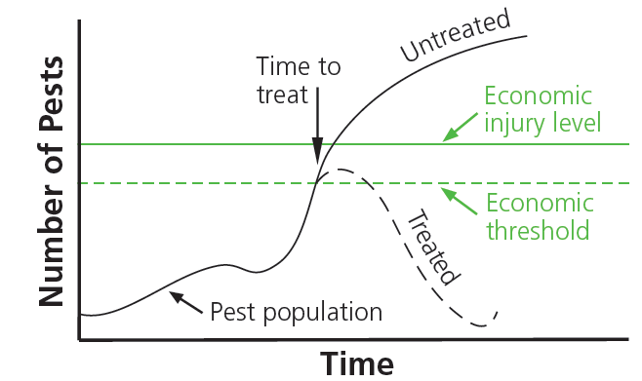
Thresholds
The level of pests when control is needed in order to prevent losses ($$$, aesthetic or ecological value)

Slide 10
What: Target Thresholds
A threshold is a level of weed infestation that justifies a control measure.
Determine:
  Where is the weed?
  How many weeds are there?
  How big are the weeds?
  How fast growing and aggressive are the weeds?

Slide 11
Scouting & Monitoring
Scouting
  Determine whether pest levels are approaching the threshold.
Monitoring
  Watching to see if control efforts succeeded.

Slide 12
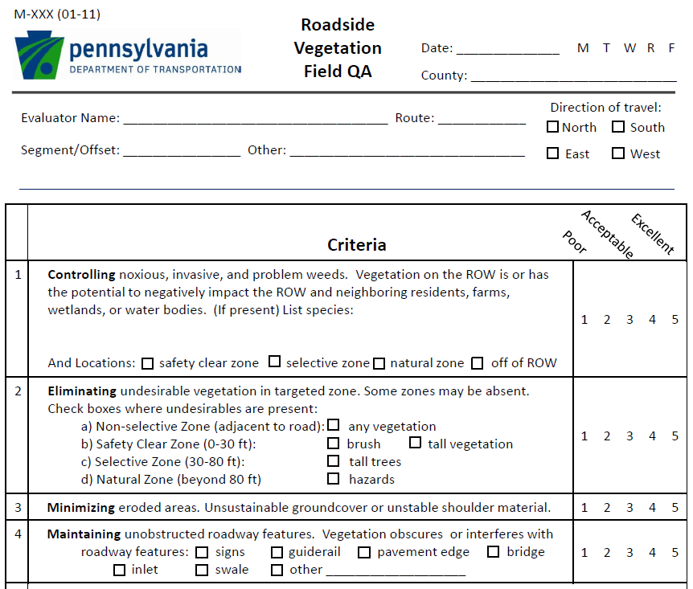
Monitoring

Slide 13
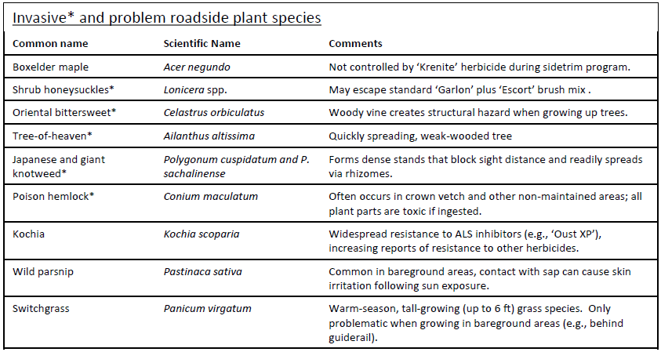
Monitoring

Slide 14
Record keeping
Provides information you need to anticipate future pest problems and prepare in advance.

Slide 15
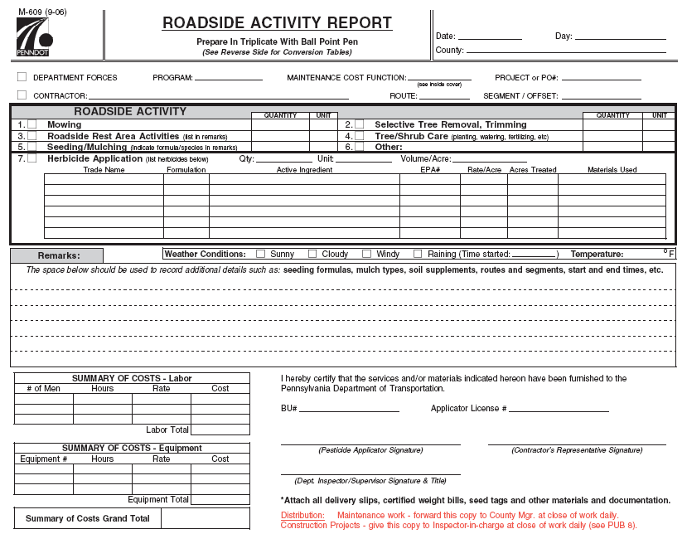
Recording: M-609 Form
Notes:
Record targets, materials used, time spent, operators, and work completed

Slide 16
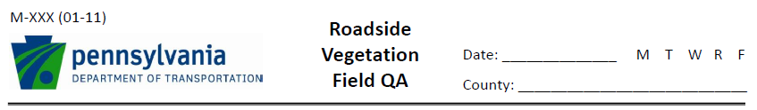
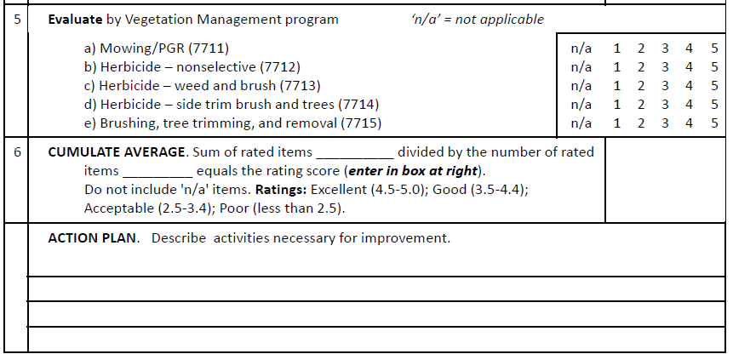
Evaluation

Slide 17
Integrated Vegetation Management (IVM)
Cultural
Mechanical
Biological
Chemical
Using them in a coordinated fashion to complement one another.

Slide 18
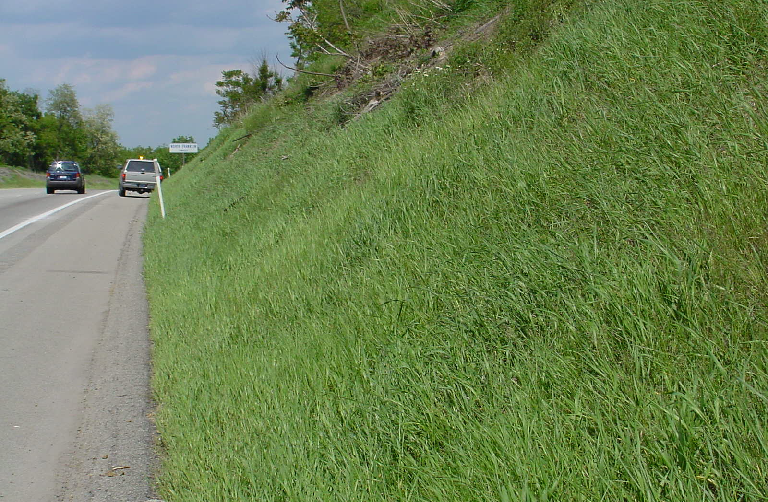
PennDOT IVM Objectives
Erosion Control
Visibility
Low Maintenance
Noxious/invasives

Slide 19
IVM and Total Vegetation Control
Uses the proper materials at the minimum rates necessary, based on the conditions at the site (e.g., soil type, weed pressure)
Example of IVM, dividing treatment sites into three categories
  Normal areas
  Sensitive areas
  Difficult areas

Slide 20
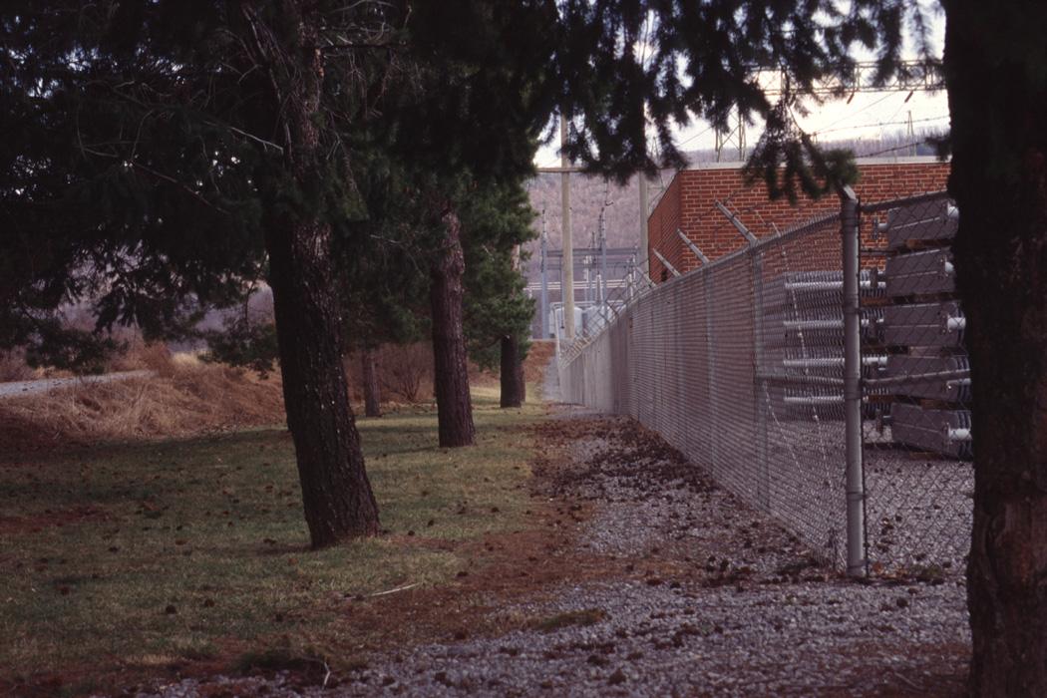

Slide 21
IVM and Selective Vegetation Management
Balance between preserving desirable vegetation and controlling undesirable vegetation.
Begins with….
  Determining targets
  Setting thresholds

Slide 22
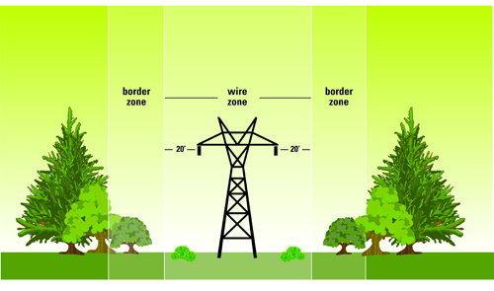
Wire Zone - Border Zone
www.ameren.com

Slide 23
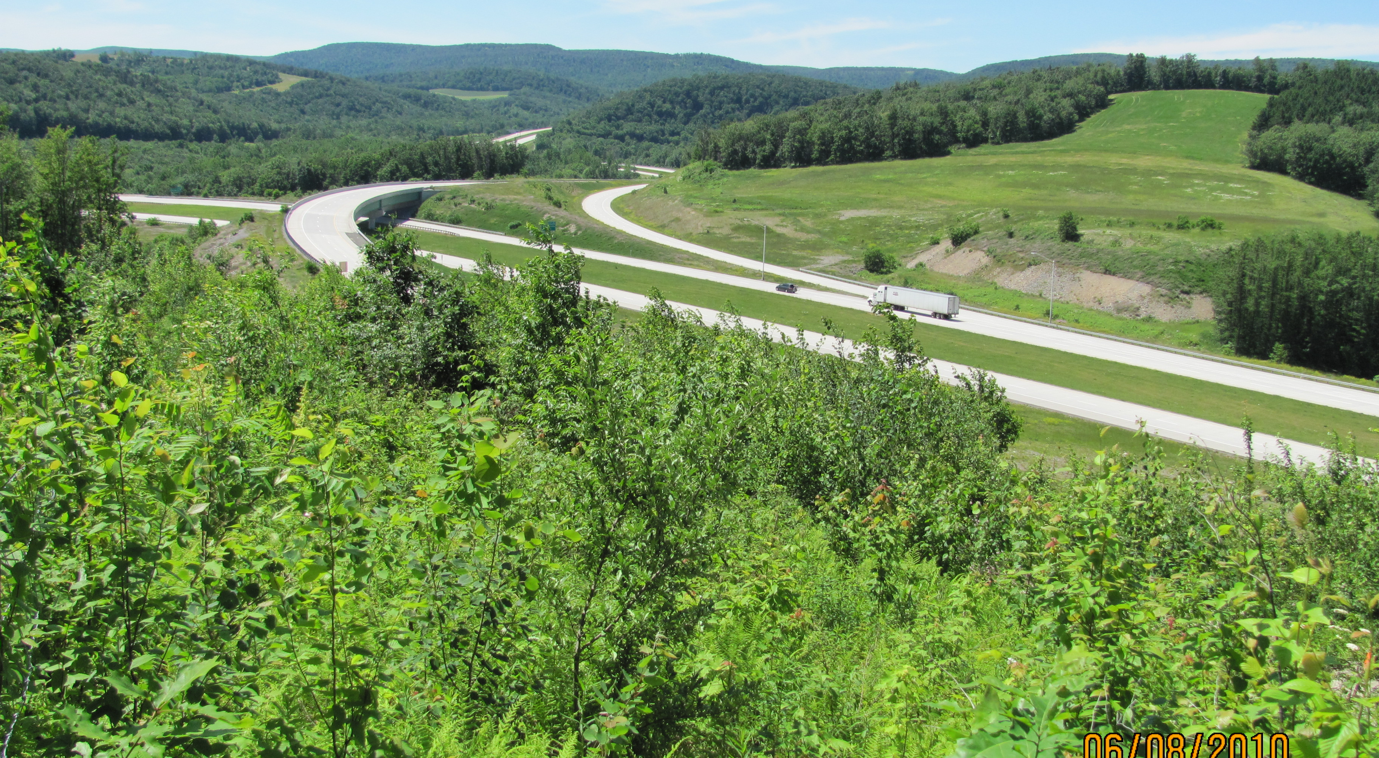
Roadside Vegetation Management Zones

Slide 25
What: Target Priorities
Desired plants:
Occupy space in the place of weeds
Preserve visibility
May need to be sacrificed in order to control weeds
Eliminate Weeds
Preserve Desired Plants
Goal: Remove weeds and preserve desirable vegetation when possible.

Slide 26
Where: the Zone Concept
'Natural' Zone
Only occurs on very wide ROW. Maintenance, if any, determined by impact on adjacent properties.
Non-selective Zone
Kept free of all vegetation to facilitate drainage, visibility, and maintenance.
Selective Zone
Kept free of problem weeds and tall-growing trees. Meadow-type vegetation encouraged.
Safety Clear Zone
Kept free of all woody vegetation for vehicle recovery and sight distance.

Slide 27
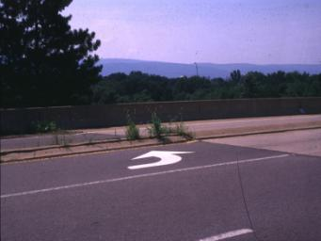
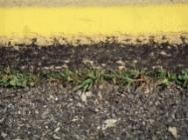
Non-Selective Zone
TARGET:
  all vegetation (bareground)
FOCUS AREAS:
  guiderails
  signposts
  shoulders
  concrete islands, barriers
OBJECTIVE:
  promote water flow off of the road surface

Slide 28
Safety Clear Zone
TARGET:
  woody plants
FOCUS AREAS:
  dependent on size of right-of-way (ROW)
  large ROWs – 30 feet from edge of roadway
  Small ROWs (secondary roads) – on a 33 foot ROW, from the outer edge of the non-selective zone to the ROW boundary (only a few feet)
OBJECTIVE:
  provide a recovery zone for vehicles that have left the travel lane

Slide 29
Selective Zone
TARGET:
  tall-growing tree species
  noxious and invasive plants
FOCUS AREAS:
  on wider ROW, extends from the edge of the safety clear zone to a distance of up to 80 feet from roadway
OBJECTIVE:
  remove trees and problem weeds through occasional mowing (once every 2-3 years) and/or periodic herbicide applications

Slide 30
Natural Zone
TARGET:
  noxious and invasive plants
FOCUS AREAS:
  on a very wide ROW, extends outward from the edge of the selective zone
OBJECTIVE:
  perform maintenance activities only if noxious or invasive weeds are present

Slide 31
Summary
IVM stresses use of multiple control methods
  What are they?, They complement one another
Weed targets based on management approach
  Non-selective (TVC)…. All vegetation
  Selective control….Keeps some desirable vegetation
Threshold levels defined by location using zone approach on right-of-way
Scouting, monitoring, and recordkeeping vital to success now and in future.
Notes:
Control methods (cultural, mechanical, chemical, biological)

Slide 32
Herbicide Characteristics
Herbicide Activity (and Selectivity)
Herbicide Formulations
Herbicide Mode of Action
Herbicide Resistance

Slide 33
Herbicide Activity (and Selectivity)
foliar vs. soil-applied
pre vs. postemergent
systemic vs. contact
soil Activity vs. non-residual
selective vs. non-selective

Slide 34
Method and Timing
Foliar – applied to the leaves and stems of the target weeds
Soil - applied to the soil; enters the plant through the roots or the germinating seed
Preemergence - applied prior to weed growth to prevent germination and establishment
Postemergence - applied after the weed has emerged or begun active growth

Slide 35
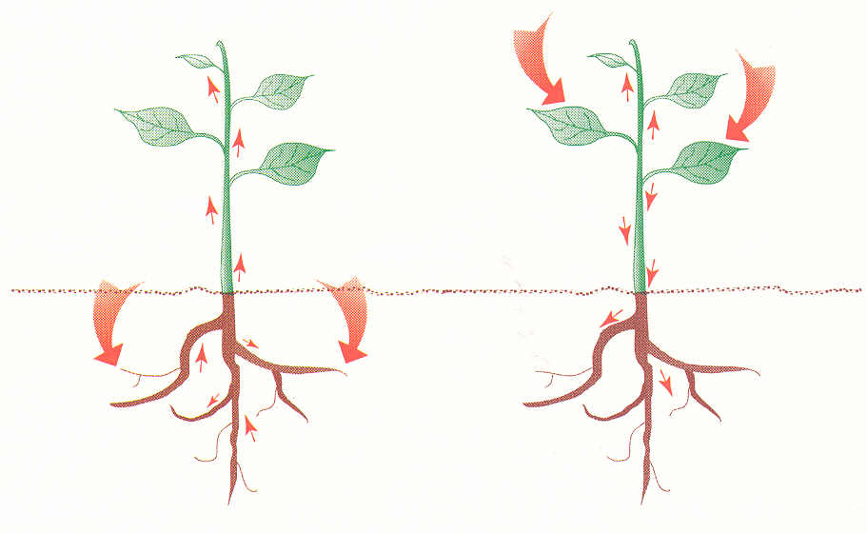
Mobility in Plant
Non-systemic (contact) – kill only parts of plant contacted by chemical; not effective for most biennial and perennial weeds
Systemic (mobile) – absorbed by roots or foliage and translocated throughout plant
Notes:
Mobility is affected by both herbicide chemistry and the amount of time it takes injury to occur. Some applications target the entire plant (eg, bareground, brush control) and some do not (eg, krenite sidetrim program).

Slide 36
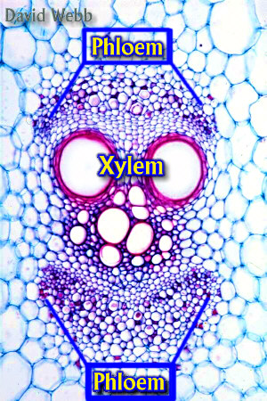
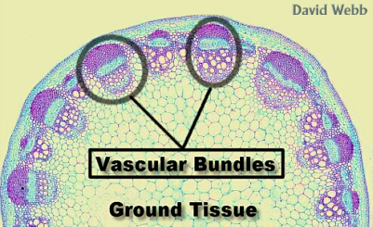
Plant Transport System
Notes:
Photo (left): typically arrangement of vascular tissue in dicot stem
Photo (right): phloem and xylem tissue in cross-section of Cucurbita (cucumber) stem

Slide 37
Systemic (mobile)
Xylem-mobile (⇑):
  diuron (Karmex XP and Krovar I)
  bromacil (Krovar I)
  hexazinone (Velpar)
Phloem-mobile (⇕):
  glyphosate (Glyphomate 41; Aquaneat)
  triclopyr (Garlon 3A and Tahoe 4E)
  metsulfuron (Oust Extra; Escort XP)
  imazapyr (Arsenal)
  Late summer and fall applications are most effective on perennial plants.
Notes:
Xylem-mobile herbicides, mainly photosynthetic inhibitors, usually move only through the xylem or upward in the plant (eg, diuron, Karmex XP and Krovar I; bromacil, Krovar I; hexazinone, Velpar).
Phloem-mobile herbicides move both upward and downward in the plant (eg, glyphosate, Glyphomate 41 and Aquaneat; triclopyr, Garlon 3A and Tahoe 4E; metsulfuron, Oust Extra, Excort XP; imazapyr, Arsenal).
*Phloem-mobile herbicides are most effective when applied to perennial plants in late summer and fall; the herbicides move belowground with the flow of sugars from leaves into perennial storage structures.

Slide 38
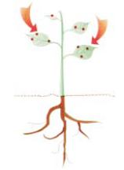
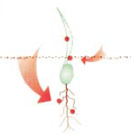
Non-Systemic (non-mobile)
Contact
  diquat (Reward), paraquat
  Fast-acting; symptoms may appear in hours
  Does not affect untreated parts
  Perennials grow back
  Can interfere with systemic herbicide activity
Preemergence
  pendimethalin (Pendulum AQ)
  Absorbed by germinating seed
  Not effective after germination
Bud inhibitor
  fosamine (Krenite)
Notes:
Due to rapid injury, contact herbicides such as diquat (Reward) do not have time to move out of treated parts of the plant. Pendimethalin (Pendulum AquaCap) controls weeds from seed, or preemergence, by acting at the growing points of root and shoot through soil contact but will not affect weeds that have already germinated. Fosamine (Krenite) is used to sidetrim encroaching brush because it prevents treated buds from opening without killing the woody stem tissue.

Slide 39
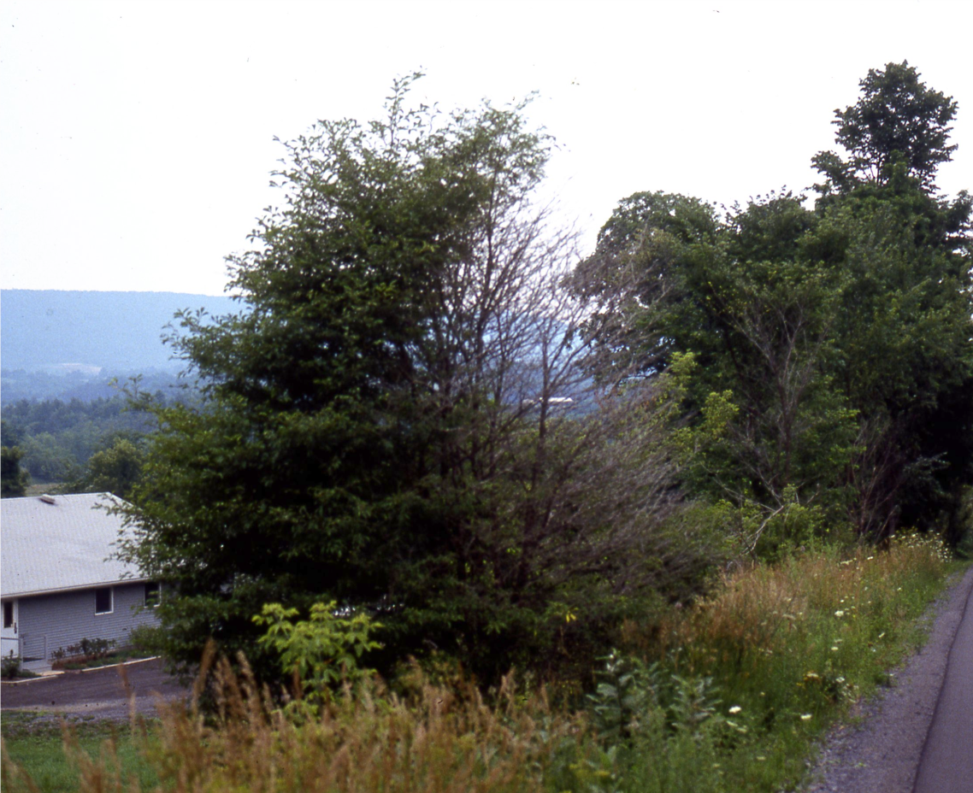
Fosamine (Krenite)
Spray direction
Sidetrim application
Notes:
Only the portion of the canopy that was contacted is injured.

Slide 40
Soil Activity – Long Residual
Prevent establishment of new vegetation
Bareground program
  sulfometuron (Oust)
  diuron (Karmex XP, Krovar I)
  bromacil (Krovar I)
  tebuthiuron (Spike 20 P)

Slide 41
Soil Activity – No Residual
Bound tightly to soil particles
Must be applied directly to plant
  glyphosate (Glyphomate 41; Aquaneat)
  diquat (Reward), paraquat

Slide 42
Control Spectrum (Selectivity)
Nonselective – injure or kill all plants treated
  glyphosate (Glyphomate 41 and Aquaneat)
  diquat, paraquat
Selective – kill weeds without significant damage to desirable plants
  2,4-D (Navigate, Triplet)
  triclopyr (Garlon 3A)
  dicamba (Vanquish, Overdrive)
  Injure broadleaf plants but not grasses
Notes:
Herbicide selectivity is influenced by application dosage and timing. Over-application of selective herbicides may result in injury to non-targets that would not be sensitive at lower rates. Nonselective herbicides may be used selectively through application timing to actively growing targets while non-targets are inactive.

Slide 43
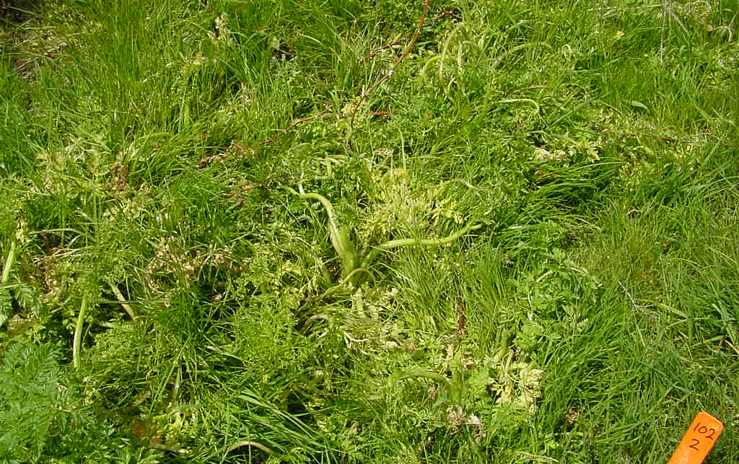
Selective Application
Poison hemlock control in grass
Notes:
Typical selective application. Garlon 3A plus Vanquish was applied to this poison hemlock growing in grass. The selective herbicides
have injured the poison hemlock and caused the twisting characteristic of synthetic auxin-type herbicides (or 'broadleaf' herbicides).

Slide 44
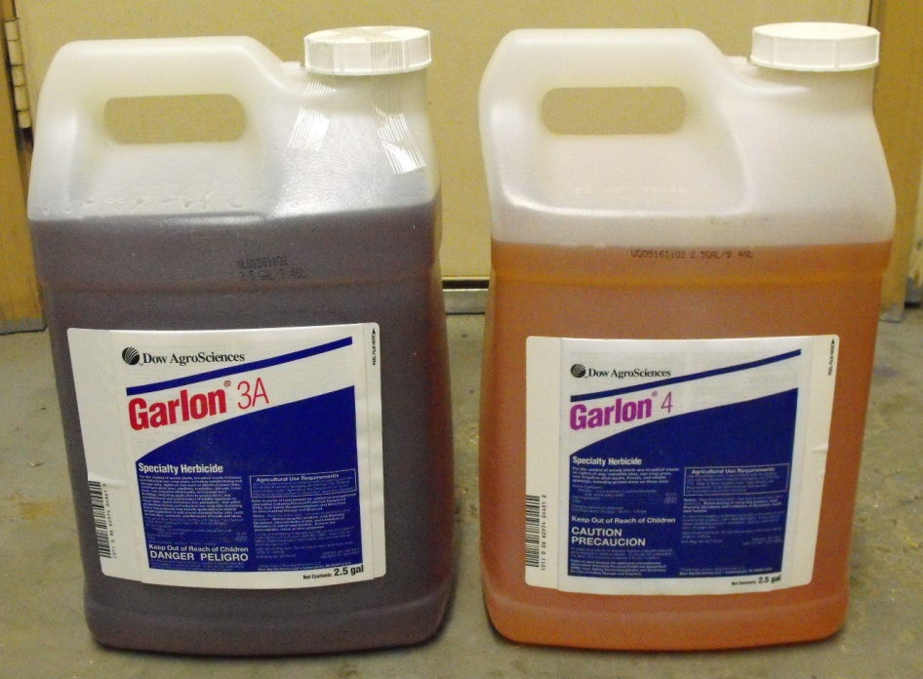
Herbicide Formulations

Slide 45
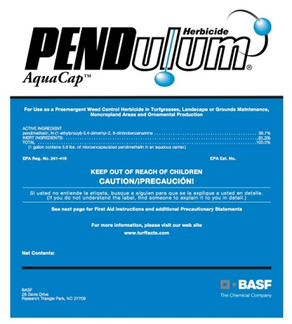
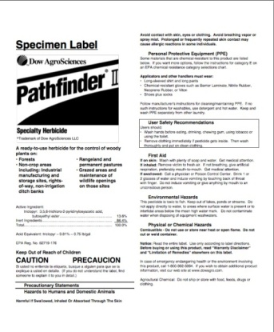
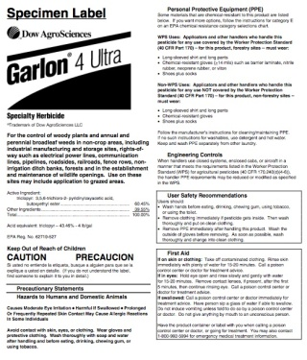
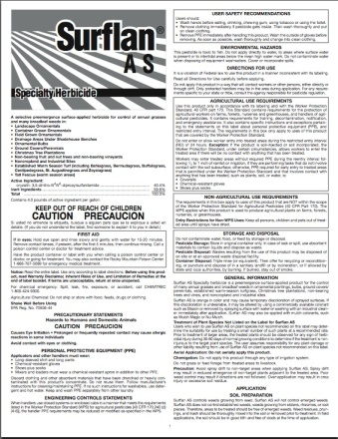
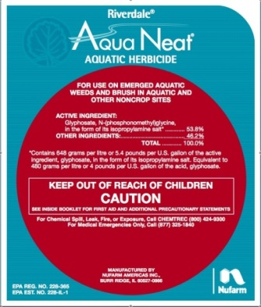
Common Liquid Formulations
Water Soluble (S)
Flowable (F,L)
Emulsifiable Concentrate (E, EC)
Microencapsulated (ME)
Ready-to-Use (RTU)

Slide 46
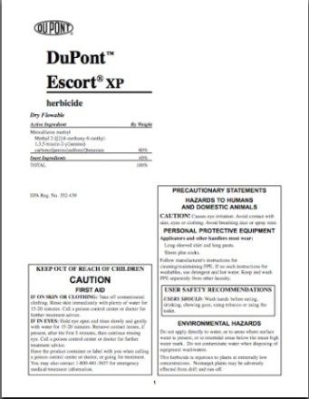
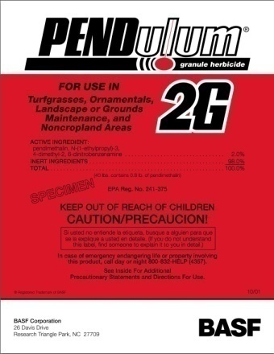
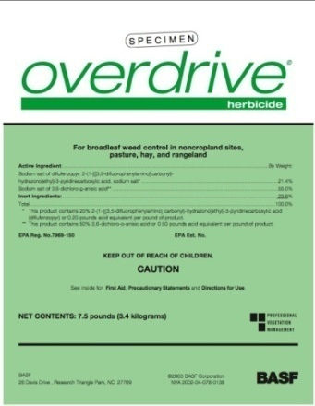
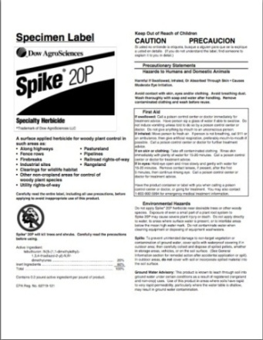
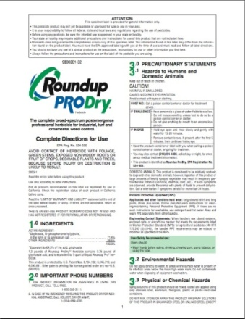
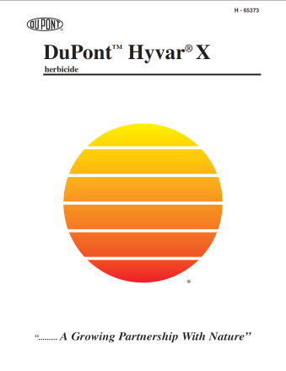
Common Dry Formulations
Granules (G) and Pellets (P)
Soluble Powders (SP, WSP)
Wettable Powders (W, WP)
Water-Dispersible Granules (WDG)/Dry Flowables (DF)/ Extruded Pastes (XP)

Slide 47
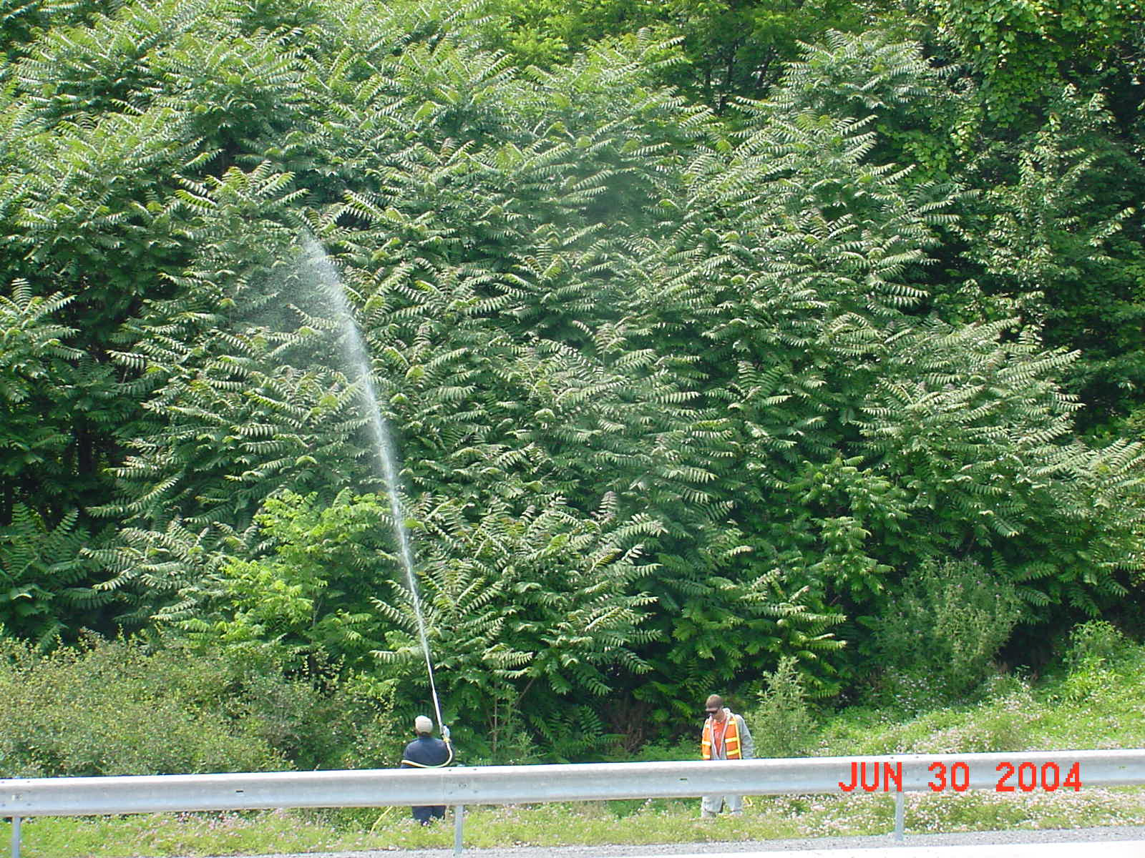
Herbicide Mode of Action

Slide 48
Herbicide Mode of Action (MOA)
How the herbicide acts, at a molecular level, from absorption through interaction with the structures inside plant cells.
Herbicides are described by MOA, site of action, and chemical family.
Several chemical families may have the same MOA.

Slide 49
Herbicide Classification
Mode of Action (Class)
Amino acid biosynthesis inhibitors
  Site of Action
  EPSP enzyme
      Chemistry (Family)
      Amino acid derivative (glycines)
        Active Ingredient
        glyphosate
          Trade Name(s)
          Roundup, etc.

Slide 50
Major Herbicide Classes (MOA)
Plant growth regulators
Photosynthetic inhibitors
  Mobile and Nonmobile
Amino acid (protein) biosynthesis inhibitors
Seedling growth inhibitors
  Root/Shoot and Shoot
Fatty acid (lipid) biosynthesis inhibitors
Cell membrane disrupters
Unclassified

Slide 51
Pesticide Resistance
The ability of a pest (insect, fungus, weed, rodent, or other organism) to tolerate a chemical that once controlled it.

Slide 52
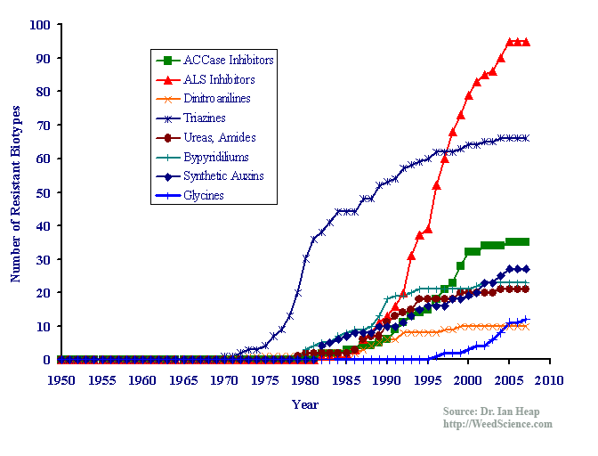
Herbicide Resistance
Notes:
Resistance occurs when a species that was originally controlled by a product is no longer controlled at rates that were previously effective. Resistance occurs when there are subpopulations or biotypes within a species that are not as vulnerable to a pesticide as the rest of a population. Repeated use of the herbicide results in selection for the resistant biotype, which will dominate the population over time. Atrazine is a photosynthesis inhibitor.

Slide 53
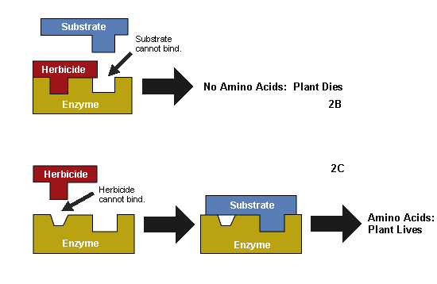
Herbicide resistance

Slide 54
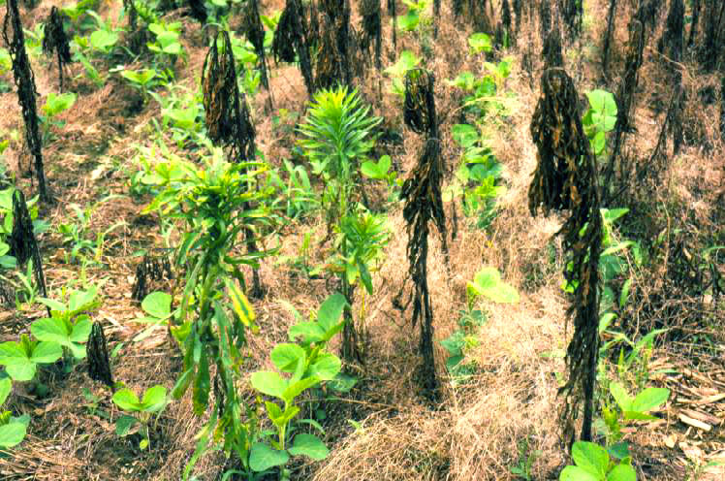
Herbicide Resistance
Use mixtures of herbicides with different modes of action.
Rotate herbicides, using different families and modes of action.
Resistance to triazines and ALS inhibitor herbicides most common
Notes:
Photo: glyphosate-resistant marestail (Conyza canadensis) in a field of Roundup-ready soybeans. Some marestail is dead, some is unaffected.

Slide 55
Site Characteristics
Vegetation
Soil
Water
Proximity to Non-targets

Slide 56
Vegetation
Annuals
  Summer annuals
  Winter annuals
Biennials
Perennials

Slide 57
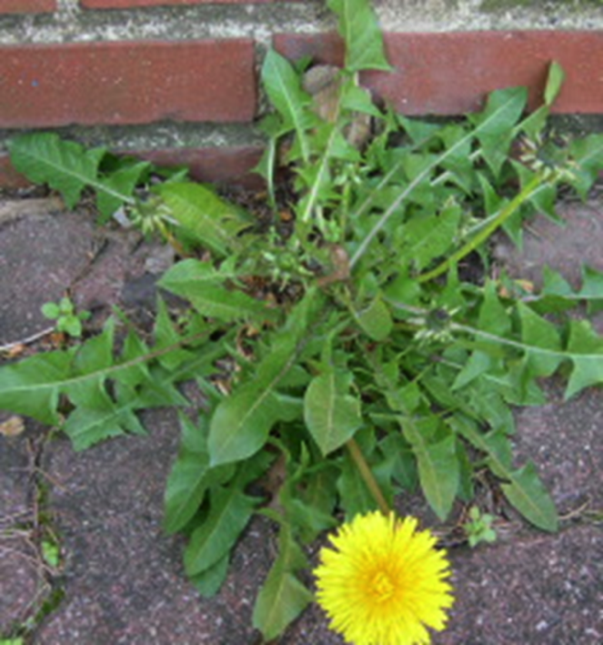
Life Cycle
The length of time for a plant to grow, flower, and set seed.
Notes:
Life cycle defines the period from germination to seed set

Slide 58
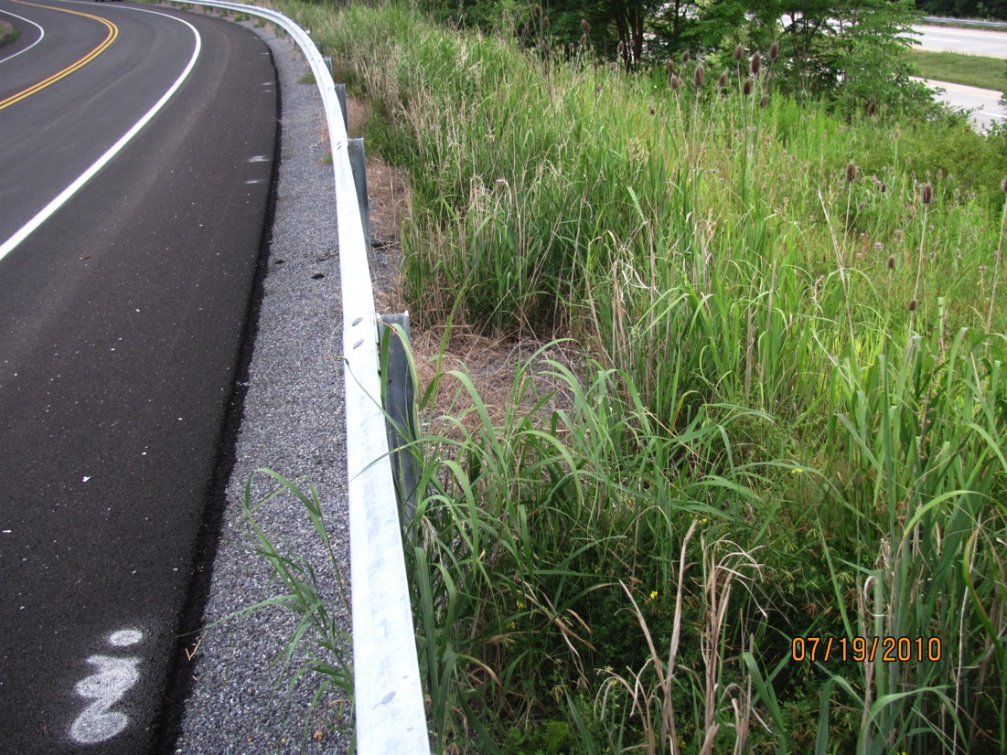
Annual vs Perennial > Root system

Slide 59
Site Characteristics
Vegetation
Soil
Water
Proximity to Non-targets

Slide 60
Soil
Determines plant species that will occupy a site.
To establish competitive groundcover (cultural control), especially on roadsides must:
  Find compatible groundcover
  Remediate the soil

Slide 61
Soil
Soil texture (particle size distribution)
  Determines capacity to adsorb herbicides
  Fine textured soils have higher capacity to adsorb herbicides
USDA particle size classes:
  Sand (2.0-0.05 mm)
  Silt (0.05-0.002 mm)
  Clay (<0.002 mm)
Gravel are larger than 2.0 mm

Slide 62
Soil
Why do clay and humus adsorb herbicides more readily??
  Clay has greater surface area than spheres or cubes of similar volume (thin, layer sheets).
  Chemically reactive carrying a negative charge (CEC).
    Thus adsorbs positively charged molecules
  Humus is negatively charged, causes aggregation of smaller soil particles, holds water.
Soil-applied herbicides often require increased rates with fine-textured soils. Decrease herbicide availability.

Slide 63
Soil
Why do clay and humus adsorb herbicides more readily??
  Clay has greater surface area than spheres or cubes of similar volume (thin, layer sheets).
  Chemically reactive carrying a negative charge (CEC).
    Thus adsorbs positively charged molecules
  Humus is negatively charged, causes aggregation of smaller soil particles, holds water.
Soil-applied herbicides often require increased rates with fine-textured soils. Decrease herbicide availability.

Slide 64
Soil
Soil permeability
  Rate at which water and air move through the soil.
  Determined by soil texture and structure.
    Soil structure is arrangement of soil particles into aggregates.
  When are highly permeable soils a concern?
If you are using highly soluble or persistent herbicides.

Slide 65
Soil
Soil permeability
  Rate at which water and air move through the soil.
  Determined by soil texture and structure.
    Soil structure is arrangement of soil particles into aggregates.
  When are highly permeable soils a concern?
If you are using highly soluble or persistent herbicides.

Slide 66
Soil
Other factors that influence herbicide movement
  Soil Hydrology
    Describes soil wetness or how close the water table is to the soil surface.
  Soil Depth
    The depth of the soil to bedrock.
Notes:
Herbicides can move rapidly with the water.
Shallow layer of soil offers greater possibility for herbicides to leach through.

Slide 67
Site Characteristics
Vegetation
Soil
Water
Proximity to Non-targets

Slide 68
Water
Important to know where water movement will occur on a site.
Establish buffer zones in sensitive areas.
  Maintain desirable vegetation in buffer zones.
Use proper herbicides and/or application methods near water.
Notes:
Look for slopes and outlets.
Look for water.
Use aquatically approved herbicides near water.

Slide 69
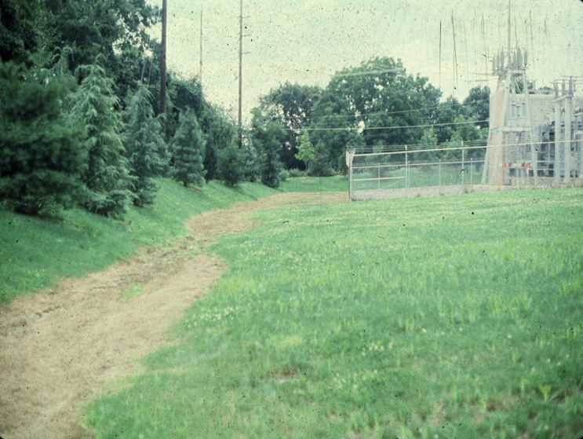
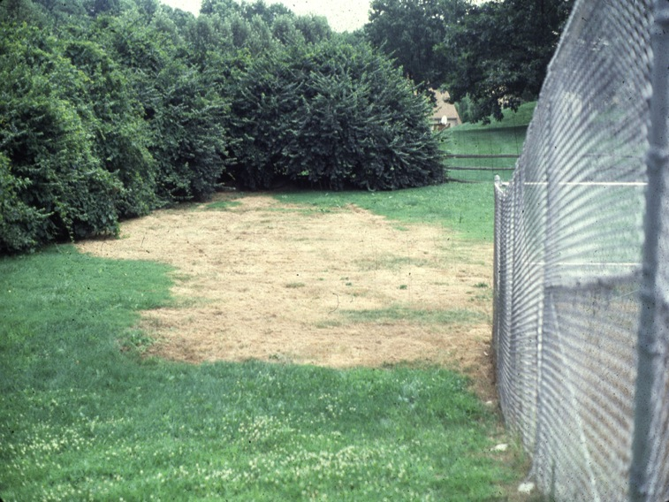
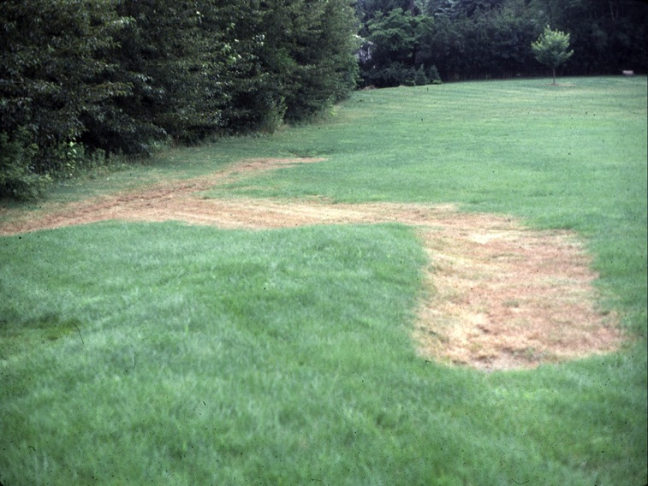
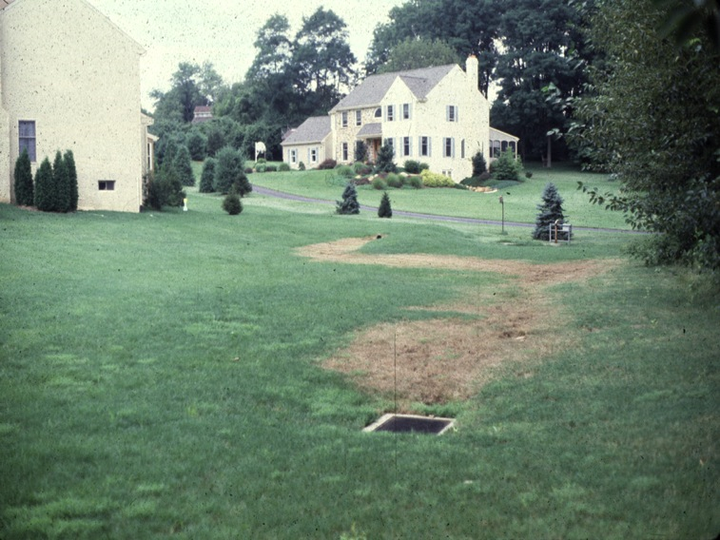

Slide 70
Site Characteristics
Vegetation
Soil
Water
Proximity to Non-targets

Slide 71
Proximity to Non-targets
Herbicides can threaten nearby desirable vegetation.
Watch for misapplication, drift, volatilization, root uptake.
  Avoid soil-active herbicides near tree roots.
  Rule of thumb, maintain distance from tree 3-5X the height.

Slide 72
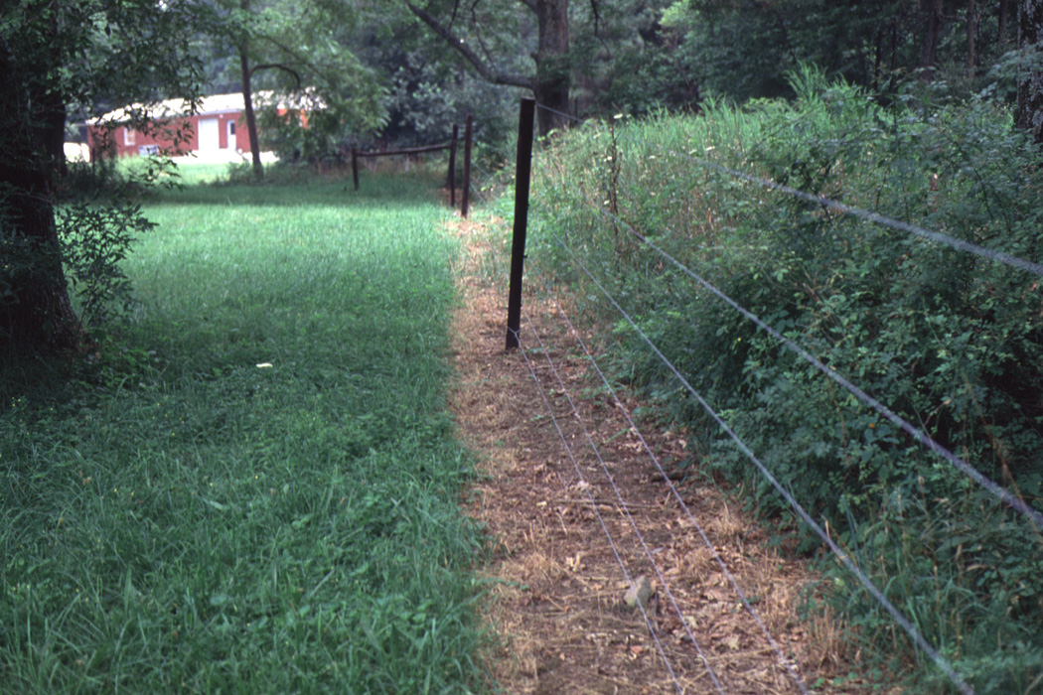
Proximity to Non-targets
root spread

Slide 73
Herbicide Application Techniques
Described later……

Slide 74
Review Questions

Slide 75
Using a physical barrier to prevent weed development is what category of IPM?
Biological
Chemical
Mechanical
Cultural
None of the above

Slide 76
The level at which a pest becomes damaging enough to warrant control efforts is which of the following?
Weed threshold
Physical barrier
Pest limit
Pest threshold
None of the above

Slide 77
IVM on a utility right-of-way is accomplished by establishing vegetation management zones called what?
Vegetation free zone
Vegetation management zone
Obstacle-free zone
Wire zone-border zone
Non-selective zone

Slide 78
Herbicides are inhibited from entering stems and leaves by which of the following?
Hairs
Evaporation
Waxy cuticle
B and C
A and C

Slide 79
Surfactants increase herbicide absorption by?
Increasing surface tension
Reducing surface tension
Lowering evaporation rate
Increasing retention
B-D

Slide 80
Phloem is the conductive tissue that?
Transport sugars to the roots
Transport sugars to the leaves
Transport sugars to the stems
Transport sugars to the “sink”
All of the above

Slide 81
Contact herbicides
Do not move within the plant
Can move within a limited region of the plant
Produce injury near where they are applied
A and C
B and C

Slide 82
Wettable powders are dry formulations that typically contain what concentration of active ingredient?
3-5 percent
5-10 percent
20-50 percent
50-80 percent
80-90 percent

Slide 83
Which mode of action mimics the action of the plant hormone auxin?
Photosynthetic inhibitors
Growth regulators
Seedling growth inhibitors
Inhibitors of amino acid synthesis
Membrane disrupters

Slide 84
Which soil particle adsorbs herbicides most readily?
Fragments
Gravel
Clay
Silt
Sand

