Slide 1
Turfgrasses – Matching the Proper Characteristics to the Site
2017 Roadside Vegetation Management Training Seminar

Slide 2
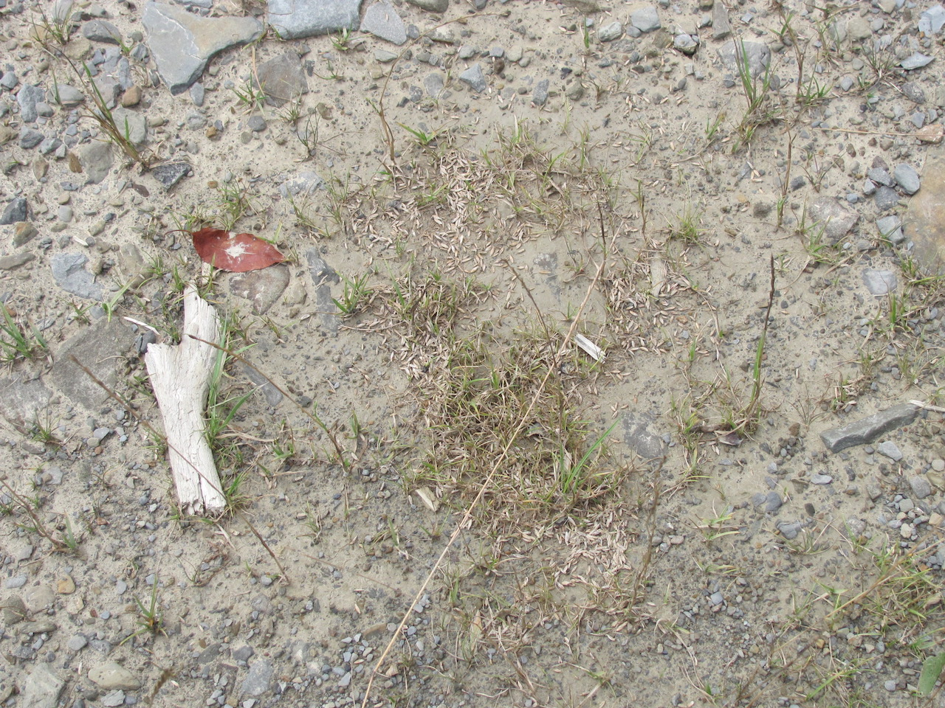
Stockpile
07/27/12

Slide 3
Cable Guiderail

Slide 4
Tree Removal

Slide 5
Rough terrain
05/27/11

Slide 6
PennDOT Formulas
Formula B
Formula C
Formula D
Formula E
Formula L
Formula N
Formula W

Slide 7
Turfgrass Species
Tall fescue
turf type vs. K-31
Fine Fescue
Hard fescue, creeping red fescue, chewings, sheep fescue
Kentucky bluegrass
Perennial ryegrass
Annual ryegrass

Slide 8
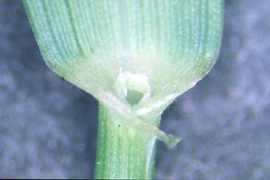
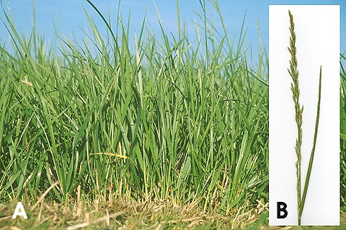
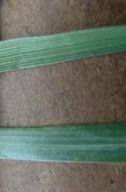
Tall fescue
Festuca arundinacea
Seed Formulas D & W
2 to 3 feet tall
bunch-type, occasional rhizomes
Sheath: round, open, reddish base
Blade: rolled, smooth and shiny underneath, distinctive veins, margins rough
Ligule: small, membranous
Auricles: very small, difficult to see with the naked eye
Seedhead: loose or compressed panicle

Slide 9
Tall fescue (K-31) Details
Adaptable to pH 5.5-7.0
Tolerates low fertility
Tolerates abuse and minimal care
Most endophyte enhanced (provides competitive advantage to plant)
Germinates quickly, robust seedlings.

Slide 10
The Fine Fescues
Narrow leaves
Medium to dark green color
Creeping Red (Festuca rubra)
Extensive rhizomes, spreads well
Seed Formulas B, D, & L
Chewings (Festuca rubra var. commutata)
Tolerates low mowing
Seed Formulas B & D
Hard (Festuca longifolia)
Drought-tolerant, low nutrient demand
Slow establishment
Seed Formula L
Sheep (Festuca ovina)

Slide 11
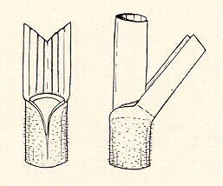
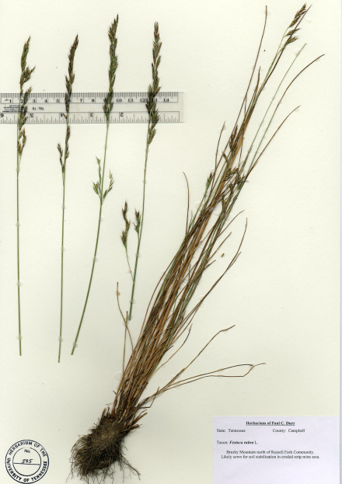
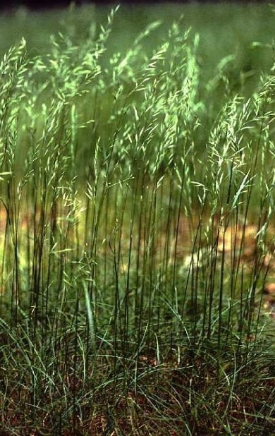
Creeping red fescue
Festuca rubra
Seed Formulas B, D, & L
Sheath: uncompressed, split part way only, fine hairs
Blade: V-shaped to closely folded, up to 6” long
Ligule: small, membranous
Auricles: absent or present as rounded extensions of the margins of the collar
Seedhead: panicle
Robert Soreng

Slide 12
Creeping Red Fescue Details
Performs well in shade or sun.
Tolerates sandy or well-drained soils.
Requires higher moisture levels than hard or sheep fescue, but survives a range of precipitation.
pH 5.5 to 6.5, but will survive in acidic soils.

Slide 13
Chewings fescue (Festuca rubra subsp. Commutata)
Bunch type grass
Common in Europe
High shoot density
Tolerant to cold temperatures, high shade
Poor salt tolerance
Disease resistant
Minimal water and nutrient requirements
Does not like heavy activity or close mowing
simplot.com

Slide 14
Hard fescue (Festuca brevipila Tracey)
Short-statured, few seedheads
Cool-season, bunchgrass
Longer, broader, coarser leaves than sheep fescue
Native to Europe
Drought resistant (between chewings and sheep)
Tremendous root system
Well drained soils, somewhat shade tolerant
lhseeds.com

Slide 15
Sheep fescue (Festuca ovina L.)
Native to Europe but in various portions of U.S., including NE
Short plants, 12 inches tall
Dwarf bunchgrass
Altitudes 1-13K feet
Dry, well drained soils
Excellent cold, good drought (>hard fescue), and moderate shade tolerance
Wide pH range
Used as groundcover
Low maintenance, low growth, dense roots, moderate traffic, little water requirement (12-24 inches/yr)
Spreads by seed
Very disease and insect resistant
Notes:
Not good forage, hay, or nesting plant

Slide 16
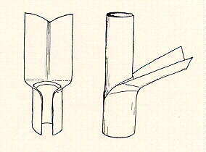
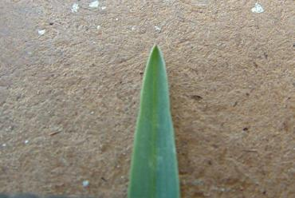
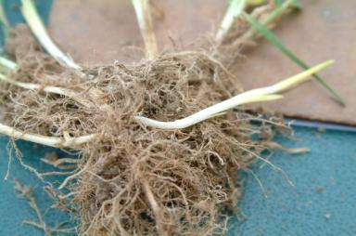
Kentucky bluegrass (Poa pratensis)
Seed Formula B
Up to 2 feet tall
Rhizomatous
Sheath: closed when young, later split with margins sometimes overlapping
Blade: folded, boat-shaped leaf tips, distinct mid vein, up to 12” long
Ligule: membranous, very short
Auricles: absent
Seedhead: panicle
Notes:
Boat-shaped tip → flatten out the blade, and the tip splits
This grass, when growing in dry situations, has its narrow blades closely folded and might easily be confused with Festuca rubra. The absence of ridges on the inner surface when the blade is unfolded will distinguish it.

Slide 17
Kentucky bluegrass Details
Forms thick sod
Palatable to livestock
Prefers well drained and fertile soils, but will establish on poorly drained areas
pH 6.0-7.5
Poor salt tolerance
Likes sun, slight shade
Goes dormant in hot, dry weather
Adding fertilizer and lime (when needed) is critical.
Susceptible to disease and insect pests

Slide 18
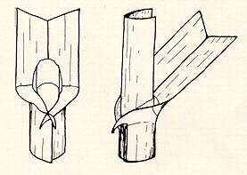
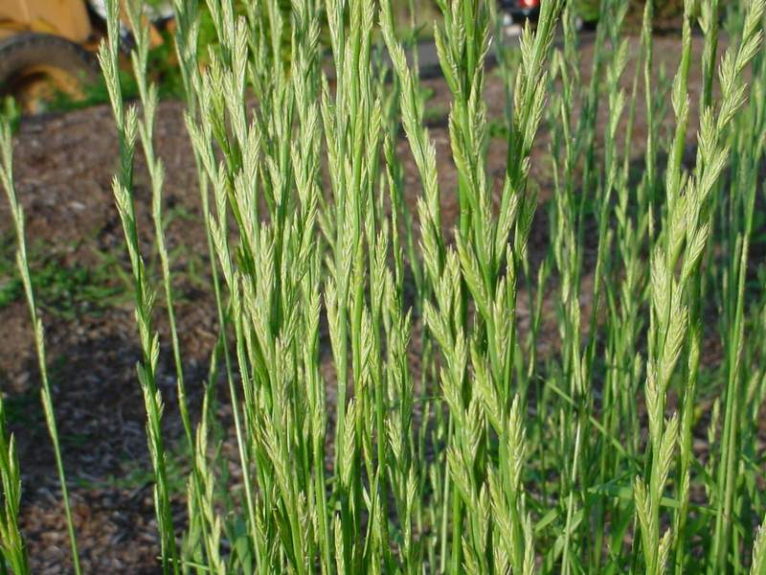
Perennial ryegrass (Lolium perenne)
Seed Formula B
2 to 3 feet tall
Bunch type
Sheath: flattened, smooth and open, reddish at base
Blade: folded, V-shaped, up to 1/8” wide and 6” long, smooth and glossy below
Ligule: small, membranous
Auricles: small, narrow, claw-like
Seedhead: spike
Richard Old
Notes:
Bunch-type = no rhizomes or stolons
This grass closely resembles L. multiflorum and Festuca elatior, from which it is distinguished by the folded leaves in the bud-shoot.

Slide 19
Perennial ryegrass Details
Likes good fertility and mild climates, not extremes of hot, drought, or cold.
Prefer good drainage
Endophyte enhanced varieties available to aid in overcoming stress.

Slide 20
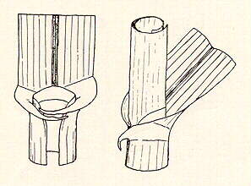
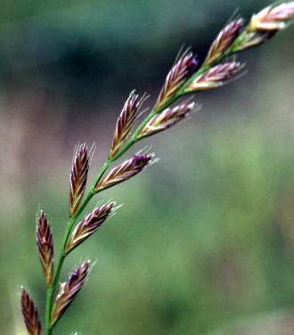
Annual ryegrass (Lolium multiflorum)
Seed Formulas C,E, & L
1 to 2 feet tall
Sheath: round, smooth and open
Blade: rolled in the bud shoot, flat, 1/8” wide
Ligule: small, membranous
Auricles: small
Seedhead: spike
Distinguished from perennial ryegrass by its rolled bud-leaves.

Slide 21
Annual ryegrass Details
Adapted to poorly drained soils, but likes fertile, well-drained soil
pH 5.5 – 8.0, best > 5.7
Quick germination and cover

Slide 22
Formula B
20% perennial ryegrass
30% creeping red or chewings fescue
50% Kentucky bluegrass
Seeding rate = 42 lbs/1000SY

Slide 23
Formula D
60% K-31 tall fescue
30% creeping red or chewings fescue
10% annual ryegrass
Seeding rate = 50 lb/1000SY

Slide 24
Formula E
100% annual ryegrass
Seeding rate = 10 lb/1000SY

Slide 25
Formula L
55% hard fescue
35% creeping red fescue
10% annual ryegrass
Seeding rate = 48 lb/1000SY

Slide 26
Seeding Dates (Pub 408, Sec 804.3)
Formula B, D, and L
March 15 to June 1
August 1 to October 15
Formula E
March 15 to October 15

Slide 27
SR4003

Slide 28
SR4003

Slide 29
SR4003

Slide 30
SR4003

